Slide 1

MFHS
Northeast Regional
Maternal Health Coalition:
Addressing Resource Gaps and Community Need
2026

Slide 2
Key Points
Substance use is a contributing factor in nearly one-quarter of pregnancy-related deaths in the United States.
Certain marginalized populations, and Black women in particular, are disproportionately susceptible to maternal mortality, with racism and discrimination found to be contributing factors in more than one-third of pregnancy-related deaths.
Many mothers rely heavily on Medicaid-provided services; however, these policies can be terminated by the states 60 days after birth. In Pennsylvania, however, this coverage has been extended to 12 months.
These challenges in maternal health are intensified by regional workforce shortages in behavioral health, obstetrics, and other medical and social support staff.

Slide 3
Regional Maternal Health Profile
Social determinants of health
Regionally, about 1 in 4 female- headed households live below the poverty level.
The food insecure population and the rate of food insecurity had increased across all northeast RMHC counties. Luzerne County had the highest food insecurity rate of the target counties, at 15.5 percent. Lackawanna County closely followed with a rate of 15.1 percent.
Community-level risk factors
These indicators include the presence of birthing facilities as well as rates of opioid prescription and risky prescribing of opioids, female arrests for opioid charges, and offenses against family and children performed by males.

Slide 4
Regional Maternal Health Profile, continued
Maternal health
These data encompass births to mothers using Medicaid as payment, trends in birth rates, infant death rates, maternal substance use, and WIC participation.
  Between 2021 and 2025, Carbon County saw the largest increase in the number of people participating in WIC (at 50.2 percent). Sullivan County had the largest decrease in participants, dropping by 32.7 percent during the same period.
  Luzerne and Lackawanna counties had the largest percentages of WIC participants compared to yearly births (at 47.6 and 38.1 percent, respectively). Lehigh and Luzerne counties had the highest number of WIC authorized retailers compared to other counties.

Slide 5
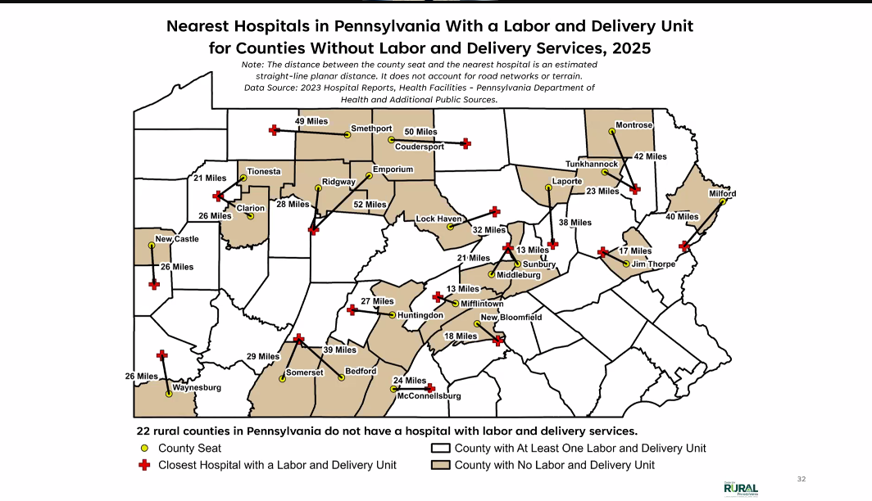
Notes:
Warren County

Slide 6
Community Input
In your experience, what are some of the biggest challenges to healthy pregnancies and post-natal well-being?
  Transportation and geographic barriers
  Knowledge support and education gaps
  Health system navigation and service gaps
  Maternal health risk factors
  Socioeconomic and structural barriers
What pregnancy related needs are unmet?
  Knowledge support and education gaps
  Health system navigation and service gaps
  Resources
Are there missed opportunities to meet these needs or to better serve people who are pregnant?
  Community awareness and connection
  Mental health support
  Transportation and geographic barriers
  Knowledge support and education gaps
  Affordability and financial barriers
What, if any, community strengths can be used to better serve people who are pregnant?
  Coordinated care
  Community awareness and connection
  Knowledge support and education gaps
  Health system navigation and service gaps
  Social and emotional support networks

Slide 7
Findings
There is a strong need for higher quality and increased availability of diverse types of services, with maternal deaths occurring during the postpartum period commonly attributed to underlying medical conditions, behavioral health issues, and lack of follow-up care.
Medicaid Coverage Gaps
  Most births using Medicaid are to women of color.
  Rural Black, Indigenous, and people of color (BIPOC) residents are at a higher likelihood of losing insurance coverage postpartum, creating care gaps during a medically vulnerable period.
Maternity Care Deserts
  The number of maternity care deserts in Pennsylvania is growing
  Hospital closures remain a significant concern, leaving rural counties with even fewer obstetricians available to residents.
Mental health and substance use intervention
  There is a need for substance use intervention with a focus on care centered on pregnant and postpartum women.
  There needs to be more education for providers and the population to remove stigma and barriers around mental health and substance use.
Scarcity
  Scarcity manifests in lack of familial support and limited community support. Many pregnant women feel isolated.
  Rising food and housing insecurity, particularly in high-poverty areas and female-headed households.

Slide 8
Findings, continued.
Overall, gaps associated with maternal well-being in northeastern Pennsylvania include:
social determinants (such as food and housing insecurity)
lack of information and knowledge about maternal health (among service providers, community members, and families)
strain on social service organizations (particularly those offering support for mental health and substance use challenges).
limited access to care (whether due to logistical challenges such as transportation and need for childcare during medical appointments, or minimal availability of care resulting from high demand and provider shortages)
Opportunities to fill these gaps range from community building and the initiation of education and awareness campaigns to the recruitment and training of professionals and advocacy for policy change.

Slide 9
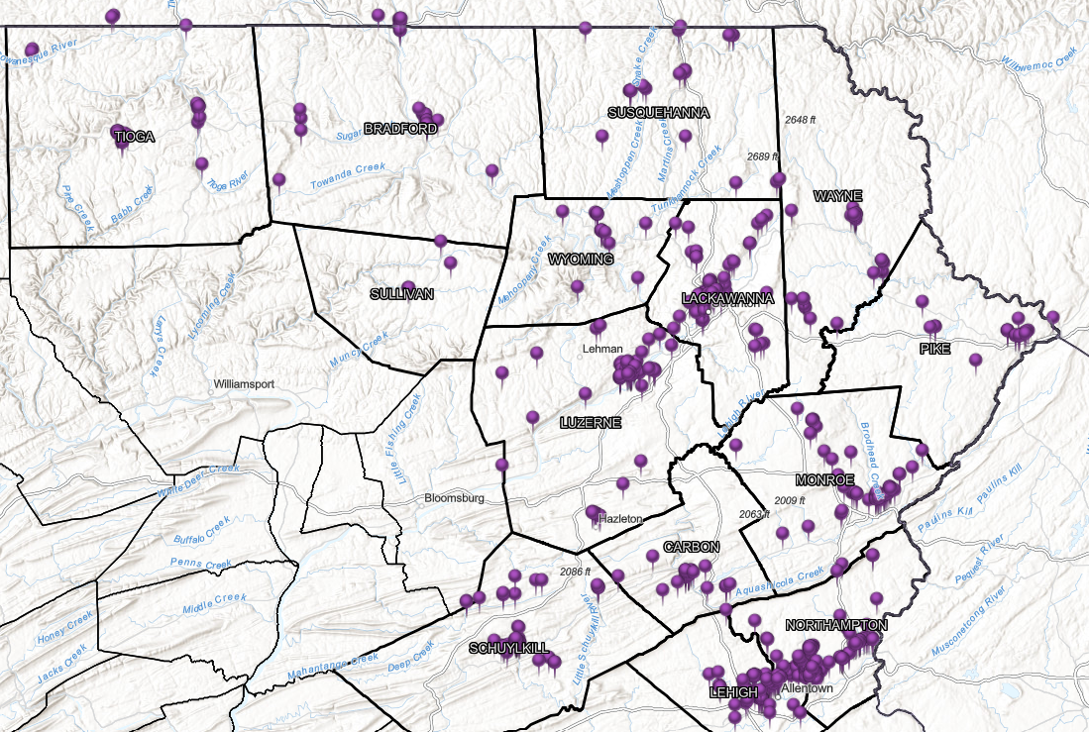
Moving Forward
Addressing maternal health disparities in this 14-county region requires a multi-layered and collaborative approach.

