Slide 1
Northeast Regional Maternal
Health Coalition
Priority Team 4
Improving Rural
Health Maternity Care Deserts

Slide 2
Priority Team 4:
Improving Rural Health Maternity Care Deserts
What barriers do rural families face?
What We’ve Learned/Explored.
What We’ve Built.
What Are Limitations/Barriers
What’s Next?
Notes:
Focused on barriers facing pregnant and postpartum families in rural counties, especially travel distance, limited providers, and maternity care deserts.
Transportation remains a significant barrier across multiple counties, with limited or nonexistent Uber, taxi, and public transportation options—particularly for prenatal, high‑risk, and delivery care.
Wyoming County has submitted a mini‑grant application to pilot a transportation support program using Uber Health, local taxi services, and gas cards. This pilot has the potential to serve as a model for other counties if successful.
We discussed EMS‑based non‑emergency medical transportation as a possible approach, including learning from the Lancaster EMS model.
Several alternative and community‑based ideas were shared (peer ride‑sharing, neighbor support, volunteer drivers), which may be longer‑term strategies.

Slide 3

What barriers do rural families face?
  Lack of services within rural communities
  Physical Health
  Maternal
  General
  Specialties
  Mental Health
  Dental

Slide 4
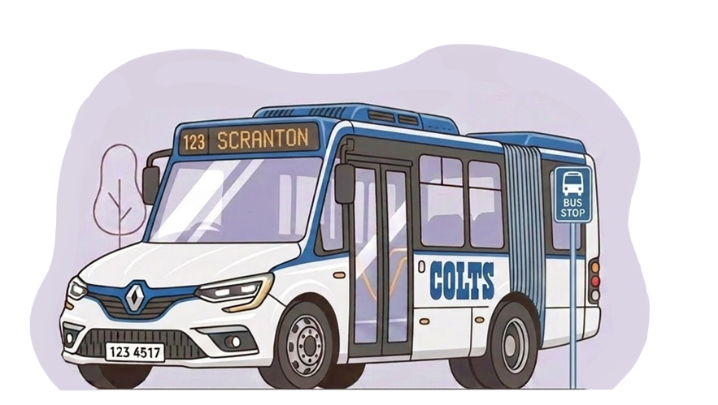

What barriers do rural families face?
  Lack of transportation: Public and Private
Notes:
Transportation remains a significant barrier across multiple counties, with limited or nonexistent Uber, taxi, and public transportation options—particularly for prenatal, high‑risk, and delivery care.
Wyoming County has submitted a mini‑grant application to pilot a transportation support program using Uber Health, local taxi services, and gas cards. This pilot has the potential to serve as a model for other counties if successful.
We discussed EMS‑based non‑emergency medical transportation as a possible approach, including learning from the Lancaster EMS model.
Several alternative and community‑based ideas were shared (peer ride‑sharing, neighbor support, volunteer drivers), which may be longer‑term strategies.

Slide 5
What We’ve Learned: Intersection of Priority Teams
  1: Access to High Quality Care
  5. Expanding and Diversifying the Maternal Health Workforce
Notes:
Priority Team 4 centered its work on piloting transportation support and sharing trusted existing maternal health resources. A key takeaway from early meetings was that rural access challenges look different from county to county, so solutions must be flexible and practical.

Slide 6
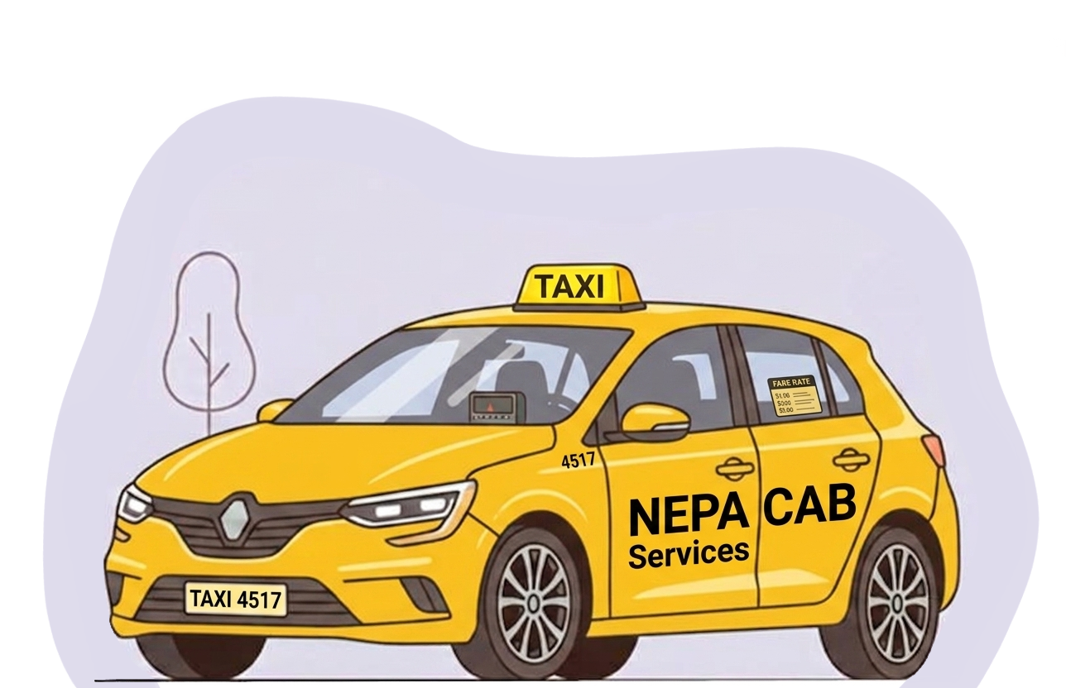
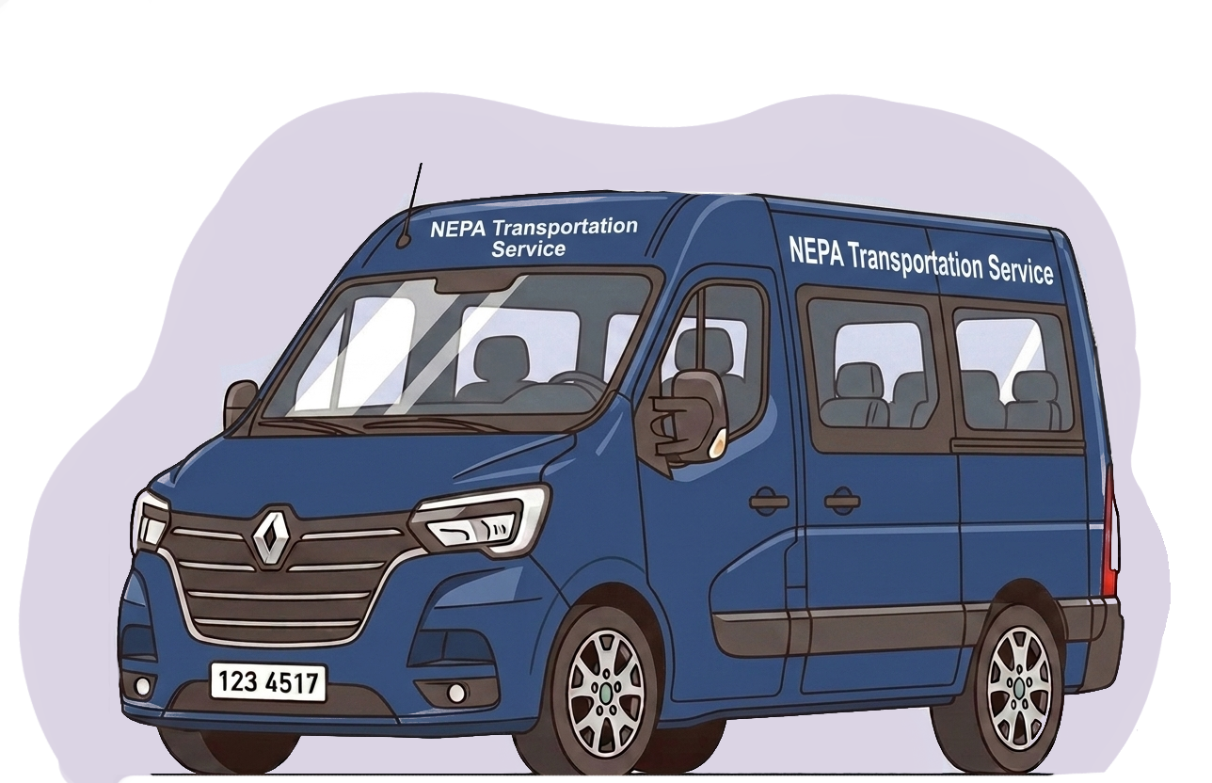

What We’ve Explored
  EMS-Based non-emergency transport
  Transportation Service
  Ride Share/Taxi
  Volunteers
Notes:
Lancaster EMS non-emergency medical transportation. Wheel chair vans and ambulances to safely transfer patients to hospital discharges, medical appointments. They are employees not volunteers. Not enough personnel in volunteer services
MA-Trsnportation services available in Countys: circulour route that can make it difficult for mothers and babies.
Trsntional Rideshare: Uber/Lift/Taxi : Lmited Availablity in rural areas.
Volunteers: who organizes, what is liablity,

Slide 7

What We’ve Built
  Pilot program to provide free health care transportation to mothers and children
  Regional Maternal Health Coalition funding
  WC Human Services
  Working with agencies
  Gas cards
  Local taxi service
  Uber Health
Notes:
Just WC now…
NFP, C&Y, PAT, HS, EHS

Slide 8
What Are the Limitations/Barriers?
  Only in one County now
  Availability of taxi service in some locations
  Ride share cancelling
  Coordination to expand to other counties
  $$$
Notes:
Althgouh Coalition working with many rural counties, only in Wyoming County now
Who Coordiations, who is lead agency. I used HS because I work for thim and it was an easy lift. Not the case everywhere.
Money money money

Slide 9
Thank You Priority Team 4 Coalition Committee Members
Occupation

