Slide 1
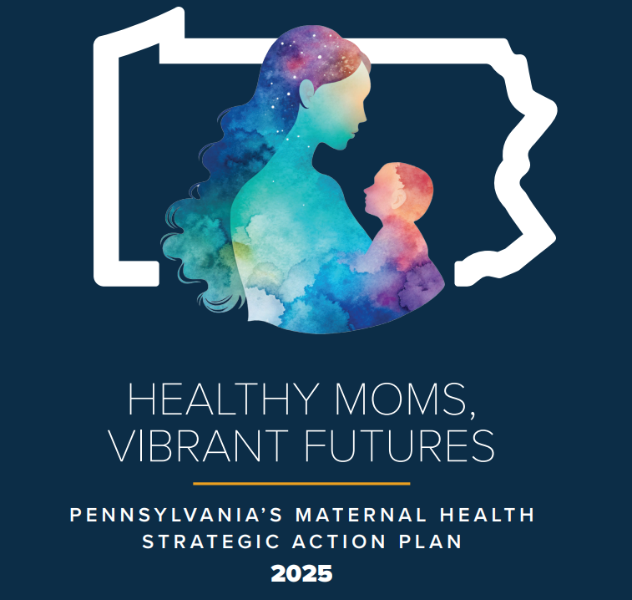




Pennsylvania's Maternal Health Strategic Action Plan: Implementation through Action
Presented to 2026 Northeast Regional Maternal Health Coalition Seminar
June 11, 2026

Slide 2
MMRC Key Findings (2021 Data):
Of the 129 identified cases of pregnancy-associated death, nearly 33% were deemed pregnancy-related and about 50% were deemed pregnancy-associated but not related.
Mental health conditions, the leading cause of pregnancy-associated death, make up about 47% of cases. Within mental health conditions, overdose and substance use disorder (SUD) are the primary causes of death.
Approximately 26% of cases had SUD identified as a contributing factor to the death.
Pregnant individuals over the age of 35 accounted for 35% of pregnancy-related deaths.
About half of pregnancy-related cases (48%) died 43 days to one year after the end of pregnancy, and 31% of the pregnancy-related cases died while pregnant.
Approximately 25% of pregnancy-associated deaths occurred while pregnant.

Slide 3
Current Maternal Health Work Across the Commonwealth
Gov. Shapiro’s 26-27 Budget proposed budget doubles down on investment, allocating an additional $7.5 million to support enhanced initiatives and infrastructure to improve care for mothers and babies.
Implementation of Women’s Services Program (DHS)
Keystones of Health 1115 waivers
Expanding Access to Women’s Health Grant (PID)
HRSA Grant that Funds the PAC (DOH)
SHIP on maternal health (DOH)
Notes:
PID Women’s Health grant – focused a myriad of important topics gleaned from research into each phase of a woman’s life:
Here is our priority list (also attached):
pregnancy
high-risk pregnancies
midwifery / doula services
labor and delivery at a birth center or other non-hospital facility
breast milk storage and human breast milk
surrogacy
infertility
infertility treatment
perimenopause and menopause
menopause screenings
perimenopause and menopause treatment
mental health
postpartum depression screening
postpartum depression coverage (e.g., mental health services, therapy, counseling, and prescribing of medications) for a duration beyond 60 days up to one year (as medically necessary)
physical health
pelvic floor physical therapy
osteoporosis
reproductive health
polycystic ovary syndrome (PCOS)
endometriosis
sexually transmitted diseases
chronic care
Alzheimer's / dementia
autoimmune
multiple sclerosis
thyroid disease
cancer risk
genetic counseling; genetic screening

Slide 4
Perinatal TiPS: Increases access to perinatal psychiatry and addiction medicine specialists via over-the-phone, provider-to-provider consultation, leading to patient referrals and connections to resources.
Diversifying Doulas Initiative: Provides doula trainings, specifically to people of color, and doula services to individuals living in Lancaster, Dauphin, and York counties.
Statewide Healthy Start Maternal Behavioral Health Initiative: Expands mental and behavioral health services and programs at all six Pennsylvania Healthy Start sites, which led to increased postpartum depression screenings and connected mothers with needed mental health services.
Perinatal and Postpartum Education Campaign: This multi-media education campaign, which ran from July 2025 through October 2025, brought awareness of Perinatal Mood and Anxiety Disorders (PMADs) and encouraged pregnant women and new mothers to seek support.
Birth Justice Philadelphia: This initiative funded $30,000 mini-grants to 10 community-based organizations working with the Philadelphia Department of Public Health to improve maternal health outcomes in Philadelphia.
Notes:
PID Women’s Health grant – focused a myriad of important topics gleaned from research into each phase of a woman’s life:
Here is our priority list (also attached):
pregnancy
high-risk pregnancies
midwifery / doula services
labor and delivery at a birth center or other non-hospital facility
breast milk storage and human breast milk
surrogacy
infertility
infertility treatment
perimenopause and menopause
menopause screenings
perimenopause and menopause treatment
mental health
postpartum depression screening
postpartum depression coverage (e.g., mental health services, therapy, counseling, and prescribing of medications) for a duration beyond 60 days up to one year (as medically necessary)
physical health
pelvic floor physical therapy
osteoporosis
reproductive health
polycystic ovary syndrome (PCOS)
endometriosis
sexually transmitted diseases
chronic care
Alzheimer's / dementia
autoimmune
multiple sclerosis
thyroid disease
cancer risk
genetic counseling; genetic screening

Slide 5
The State of Maternal Health in PA: What’s the latest?
From the headlines:
The Pro-Life Movement's Cruelty Problem - Two proposed bills threaten to worsen pregnancy outcomes and increase intimate partner violence
Medicaid Work Requirements and Access to Perinatal Care
Melinda French Gates on Menopause, Midlife, and the $600 Million Push to Fix Women's Health
In a First, Scientists Precisely Edit Human Embryo Genes
Notes:
There is a lot of recent news coverage and conversation – not to mention rallies for more funding for rape crisis centers, etc. – about IPV and restrictions on reproductive care. Pregnancy is a known risk factor for escalating intimate partner abuse. Simultaneously a tool of control by an abuser and a narcissistic injury to the abuser -- it represents a shift in the victim's focus from the abuser to the pregnancy and therefore a perceived rejection -- it has potentially lethal consequences for victims, with homicide, most often with a firearm, as the leading cause of maternal mortality in the U.S.
Reproductive coercion is inextricably linked to domestic violence, and indeed the erosion of reproductive rights post-Roe has highlighted that dangerous public health association. Abortion restrictions enacted in "trigger-ban" states after Dobbs were found to significantly increase rates of intimate partner violence for reproductive-age women and predicted to add an estimated $1.2 billion in social costs. The evidence is clear. These restrictions are expensive, draconian, and overtly dangerous for patients.
Within the last month, two alarming developments in the "pro-life" fight illustrate the increasing cruelty within the movement, putting women at increased risk of health complications both from pregnancy and intimate partner violence.
House Republicans proposed a federal ban on dilation and evacuation, a common abortion method in the second trimester and an important component of miscarriage care. The legislation states that efforts to save the life of the mother are exempt, but we know from experience that such exceptions are often ineffective, as the threat of criminal consequences invariably has a chilling effect on doctors' and hospital lawyers' willingness to act to save the mother.
The leading champion of the ban is Rep. Kat Cammack (R-Fla.), whose own reproductive care for a life-threatening ectopic pregnancy was thrown into chaos under Florida's abortion restrictions, which confused doctors and caused them to delay her care.
You'd think such a harrowing experience, variants of which have brutally killed other women, would inspire empathy and thoughtfulness around healthcare legislation. You'd think Cammack would have developed a personal appreciation of the fact that miscarriage care overlaps heavily with abortion management (other lawmakers have demonstrated their ignorance here) and that blanket bans on medical care that threaten doctors serve no one.
Yet, Cammack continues the same trend of uninformed and bullish legislation, which will have consequences for patients like her who emergently need miscarriage care.
Codifying Personhood and Defining Abortion as Murder
A controversial North Carolina bill introduced by Republican Representatives codifies fetal personhood and defines abortion as murder. It legally condones use of force, even lethal, to defend the life of another, under the definition of life delineated by fetal personhood.
HR1 and work requirements under MA… some exemptions (see other notes!)

Slide 6
The State of Maternal Health in PA: What’s the latest?
From the headlines:
HHS launches moms.gov
PA AG files appeal to PA Supreme Court ruling on mifepristone
Alabama woman forced to give birth on jail floor, suit says: ‘I have nightmares that we both died’
Dr. Oz says 1 in 3 Americans are ‘underbabied’

Slide 7

The State of Maternal Health in PA: What’s the latest?
From the headlines:
“Pennsylvania supports its mothers with a 5-year maternal health strategic action plan,” WVIA, May 2026
Good news at last!
“Inside the Shapiro administration’s ‘absolutely ambitious’ plan to prevent maternal deaths,” Spotlight PA, April 2026
“Combating stubbornly high Black maternal mortality with ‘Justice and Joy’ in Pa.,” Pennsylvania Capital-Star, April 2-26
“UPMC expands women’s mental health services,” Fox 43, June 2026
Notes:
Everyone take a deep breath!

Slide 8

Notes:
Amid panicky times is the perfect time to breath, regroup, prioritize, and take action – as PA has done with its Healthy Moms, Vibrant Futures plan.
If you have yet to read it or want an old-school hard copy – I have some with me – or this website provides a link…

Slide 9
Project team included participants from:
Department of Health
Department of Human Services
Department of Drug and Alcohol Programs
Pennsylvania Insurance Department
Team tasked with:
Reviewing data
Gathering information from listening sessions and survey
Identifying current initiatives to expand upon
Notes:
A quick-ish overview of the plan, which many of you have been involving in developing and implementing.

Slide 10

The Five Ps of Healthy Moms, Vibrant Futures
Priorities
Process
Plan
PAC
Participate

Slide 11

Priorities
Improve perinatal health outcomes by supporting access to and utilization of high-quality perinatal care.
Improve detection of behavioral health risks during pregnancy and postpartum and improve referrals and uptake of treatment and supports.
Strengthen maternity care resources in rural communities and maternity deserts.
Increase awareness of and utilization of supports that address health-related social needs.
Build improved trust and better connections between patients and providers.

Slide 12
Plan: Vision and Mission
Healthy Moms, Vibrant Futures – Pennsylvania’s Maternal Health Strategic Action Plan
Vision
A Pennsylvania where every pregnant and birthing individual has easy access to high-quality perinatal, birth and postpartum care that is person-centered, comprehensive, equitable, and affordable and that results in healthy outcomes and the potential for long-term good health and wellbeing.
Mission
Through Healthy Moms, Vibrant Futures, the Shapiro Administration will implement a dynamic maternal health strategic plan with actionable strategies to address the state’s maternal mortality and morbidity rates—particularly among Black women and birthing individuals—and promote long-term health and wellness.
Equity is at the center of the plan.

Slide 13
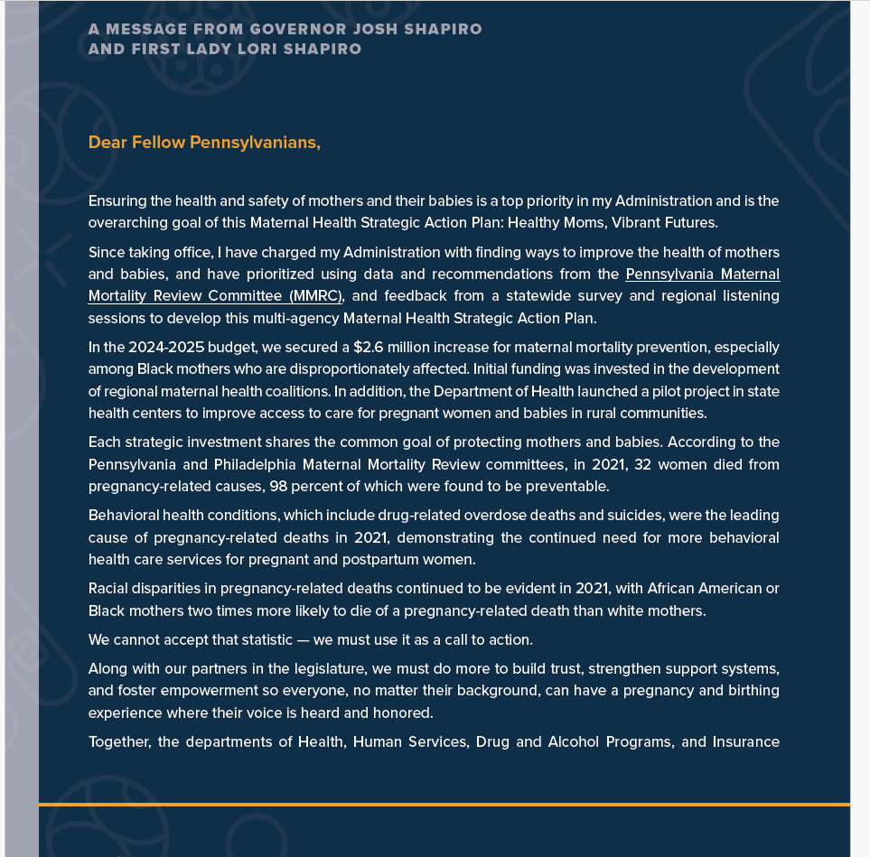
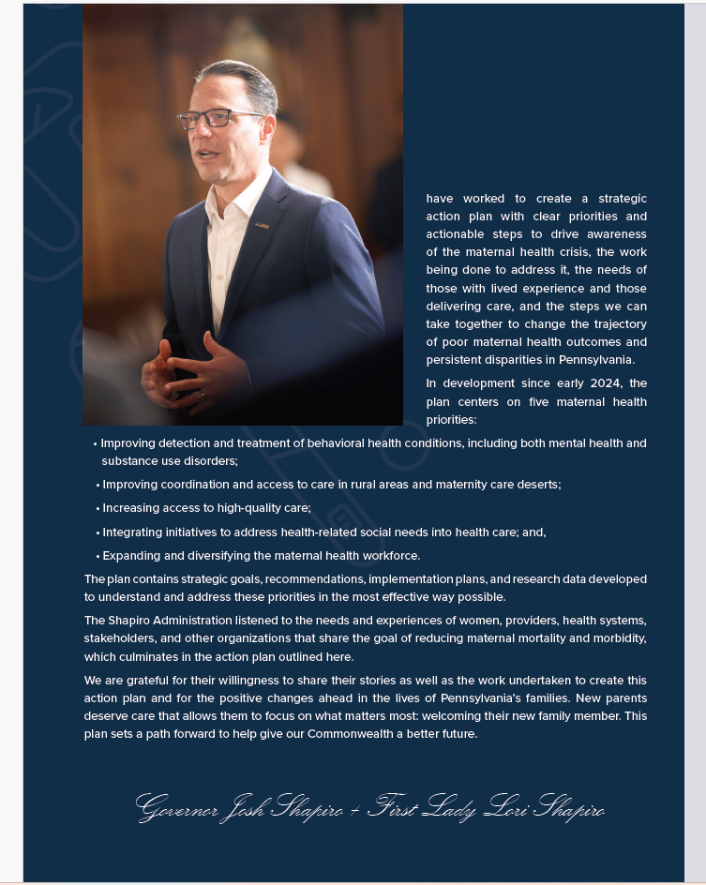

Slide 14
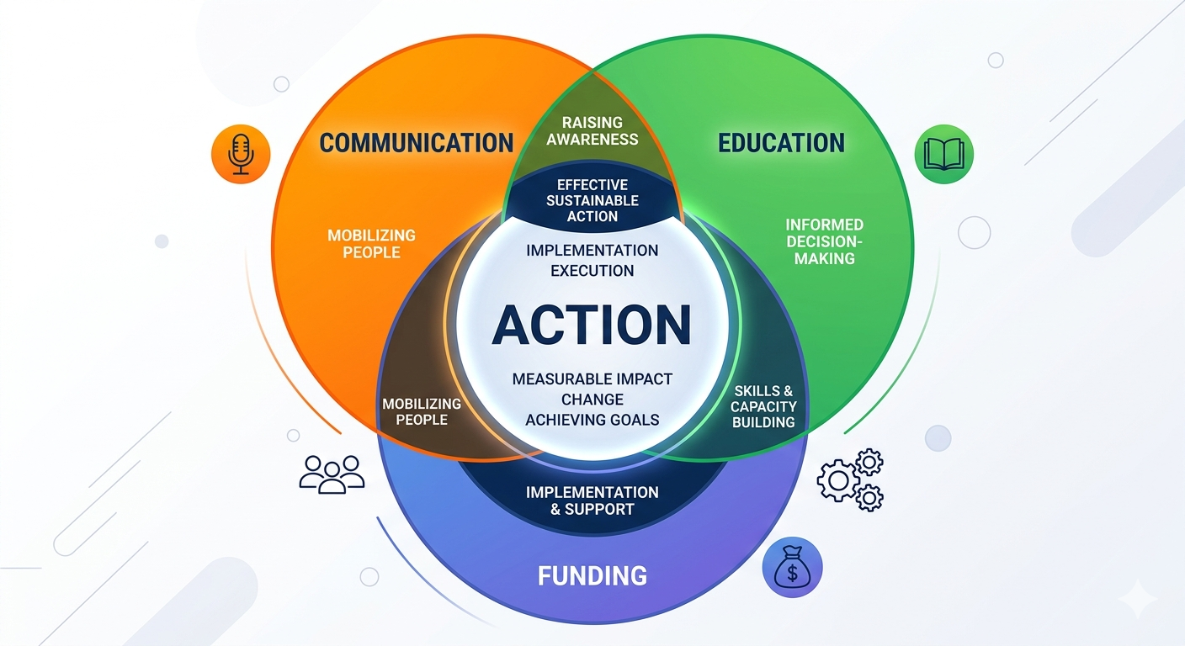
Notes:
This is what the action plan is all about – yes, action at the center. Measurable objects, initiating change, achieving goals… this is the PAC!

Slide 15
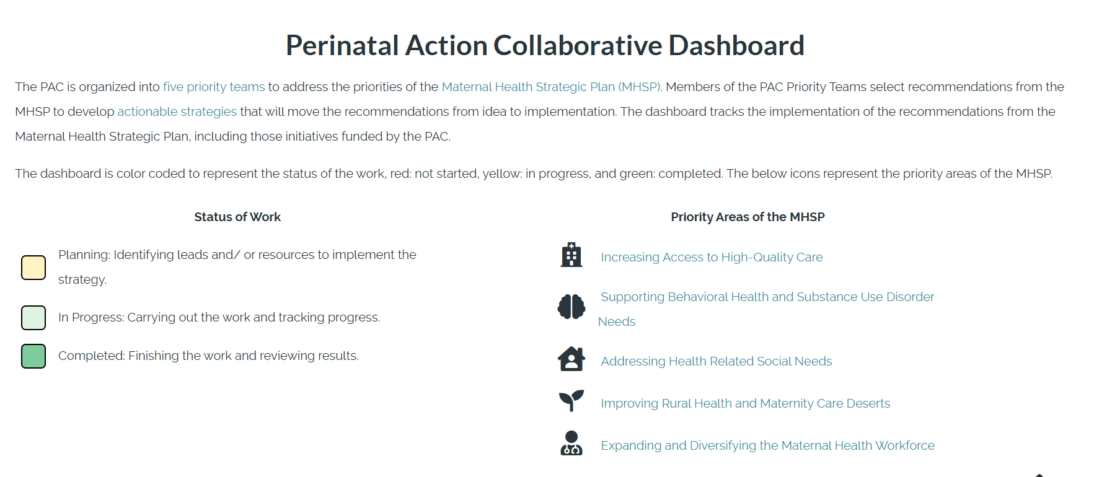
Notes:
Tracking the progress of the 160+ PAC members who comprise priority workgroups is among the many topics covered on the PAC website… the dashboard outlines the status work among each of the priority areas.

Slide 16
Action Plan –
Perinatal Action Collaborative (PAC)
PAC includes:
Stakeholders, providers, community-based organizations, government and people with lived experience
PAC tasked with:
Prioritizing recommendations and mobilizing action to implement strategies that will improve the health of women and pregnant and postpartum individuals in the Commonwealth.
Notes:
To give you a status on where we are with the plan, here is an overview of most current priority projects.

Slide 17
Action Plan –
Perinatal Action Collaborative (PAC)
MHSP Priority Area: Increasing Access to High-Quality Care
Recommendation: Increase utilization of non-medical supportive services that can support greater cultural competency in perinatal care and improve health outcomes, like community health workers, peer services, and doulas by working with providers and payors to encourage greater partnership with and referrals to non-medical providers.
Actionable Strategies: Improve Access to “Non-medical” supports
Lead: Fabric Health
Notes:
For access to high quality care the recommendation was to increase utilization of nonmedical supportive services.
Fabric Health was awarded to address barriers to accessing perinatal care. Fabric Health works with mothers and families at laundromats, turning a weekly chore into an opportunity to solve urgent needs. Their navigators provide pregnant and postpartum individuals with resources to address food insecurity, utility insecurity, access to transportation, and insurance coverage, among other pressing needs. The current programs are taking place in Allegheny and Philadelphia counties.
Fabric Health reported serving 1,246 individuals in the first quarter.
Funding amount: $150,000

Slide 18
Action Plan –
Perinatal Action Collaborative (PAC)
MHSP Priority Area: Increasing Access to High-Quality Care
Recommendation: Increase utilization of non-medical supportive services that can support greater cultural competency in perinatal care and improve health outcomes, like community health workers, peer services, and doulas by working with providers and payors to encourage greater partnership with and referrals to non-medical providers.
Actionable Strategies: Improve Access to “Non-medical” supports
Lead: Franklin Pediatrics
Notes:
Another access to high quality care implementation is with
Franklin Pediatrics, in Venango County, who was awarded to provide services to postpartum individuals at their child’s pediatrician visit. Many postpartum individuals attend their infant’s pediatric visits, even when they do not have access to or time to take for their own postpartum care. This uniquely positions a pediatrician’s office to fill gaps in postpartum care. With this funding Franklin Pediatrics will expand its services, including lactation supports, postpartum mental health and wellness, and social care navigation that includes screening and warm handoff to resources for food, housing, and WIC.
Franklin Pediatrics is currently focusing on technology supports (EMR integration, etc.,) to successfully expand services.
Funding amount: $150,000

Slide 19
Action Plan –
Perinatal Action Collaborative (PAC)
MHSP Priority Area: Supporting Behavioral Health and Substance Use Disorder Needs
Recommendation: Develop a mechanism for universal postpartum depression screenings and faster mental health and SUD referrals to support new mothers, which can also improve access to care and resources for women experiencing postpartum depression and improve integrated care programs and expanded mental health and SUD services.
Actionable Strategies: Improving Education and Screening via an App or Website
Lead: Materna Phia Health
Notes:
To support Behavioral health and SUD needs the PAC wanted to make screenings and referrals easier. To do this they are working with Phia Health who was awarded to support a statewide initiative to deploy a behavioral health platform that supports pregnant and postpartum individuals across Pennsylvania. The platform provides evidence-based perinatal mental health screenings, continuous risk detection, and rapid escalation to licensed clinicians and care coordinators. This approach proactively identifies behavioral health risks and ensures connection to treatment – so people aren’t showing an identified need and not receiving services. The initial phase of this initiative will focus on select urban and rural counties, with plans to expand statewide.
Phia Health’s current work is focused on platform readiness, operational start-up activities and the determination of the counties to pilot.
$150,000

Slide 20
Action Plan –
Perinatal Action Collaborative (PAC)
MHSP Priority Area: Improving Rural Health and Maternity Care Deserts
Recommendation: Collaborate with state agencies and other partners supporting rural healthcare development to leverage existing groups, venues and resources around rural health to assess available resources, determine needs, and work to create collaborative efforts in counties and regions and across payors to address lack of maternal care.
Actionable Strategies: Expanding the Role of Pharmacists in Maternity Care
Lead: University of Pittsburgh School of Pharmacy, with Pennsylvania Pharmacists Care Network
Notes:
For improving rural health and maternity care deserts the PAC wanted to leverage existing groups rather than reinventing new initiatives.
The PAC is working with the University of Pittsburgh School of Pharmacy to expand access to maternal health services within pharmacies in rural counties and maternal health deserts. The Pennsylvania Pharmacists Care Network (PPCN) is a statewide clinically integrated network of nearly 200 community pharmacies in 48 counties across Pennsylvania who can provide enhanced patient care services.
In May 2025, the network launched a pharmacy-based maternal health program which provides pregnant and postpartum individuals with blood pressure screenings, safe medication guidance, social needs assessments, and prenatal nutrition advice. The program also connects them to additional services, including doulas, postpartum behavioral health support, diaper and milk banks, and home-visiting programs. These funds will expand the pharmacy-based maternal health program to an additional eight pharmacies serving counties with moderate, low, or no access to maternal healthcare access. Some of those counties include Greene, Mercer, Venango, Clarion, and Clearfield counties.
The University of Pittsburgh began work to coordinate the eight Pennsylvania Pharmacists Care Network pharmacies to participle in the learning collaborative. Invitations were sent out and draft agreements with participating learning collaborative pharmacies were started.
Funding amount: $150,000

Slide 21
Action Plan –
Perinatal Action Collaborative (PAC)
MHSP Priority Area: Addressing Health Related Social Needs
Recommendation: Explore and support existing policies and programs to improve housing and food security and access to transportation for pregnant and postpartum individuals and their families.
Actionable Strategies: Improve connections between community-based organizations (CBOs) and managed care organizations (MCOs), to increase utilization of the PA Navigate service, to provide support to expand CBO services, and to improve HRSN screening tools.
Lead: Numerous
Notes:
Note to Dr. Bogen – the remaining subcontracts were just implemented so we don’t have any progress to report.
With Pennsylvania’s diverse make up, the PAC decided that for health-related social needs smaller localized projects made more sense.
The first actionable strategy focuses on providing additional support to CBOs in Pennsylvania that have had an increase in referrals and demand for services around housing, food security, and transportation. Each of the following CBOs received $32,580 to support increased demand for their services:
ACLAMO will provide care and expand their bilingual capacities to 120 pregnant and post-partum people in Montgomery County over 10 months. This care will help pregnant people progress toward health milestones.
The Foundation for Delaware County will implement a Family Village Transportation Initiative to address the transportation needs of pregnant and postpartum people in Delaware County to help increase attendance at health care appointments.
The Family Health Council of Central PA will implement a SafeSeat Connect project, which will provide appropriate car seats and car seat safety education to low-income pregnant and postpartum people at eight Pennsylvania WIC locations.
Fulton County Family Partnership will institute a Mobile Maternal Safety Net. This program will ensure access to necessary resources and equipment for pregnant people in Fulton, Huntingdon, and Franklin Counties.
Linked Family Services will expand their Tiny Essentials Relief Hub to increase access to infant essentials for birthing families in Lancaster and the surrounding areas to meet increased demands and referrals from families in need.
Northern Tier Community Action will increase community access to infant supplies for pregnant and postpartum people by coordinating with Head Start Centers, Food Pantries, and Social Service programs in Cameron, Elk, McKean, and Potter Counties.
Volunteers of America of Pennsylvania will enhance maternal education and resource distribution, provide workforce training for workforce reentry after birth, and provide a Parent Peer Support program for pregnant and postpartum people across Pennsylvania.
Peer-to-Peer Exchange
To improve connections between CBOs and MCOs, the actionable strategy focuses on establishing and facilitating a peer-to-peer exchange among MCOs, their contracted HRSN services, and CBOs (“buddy systems”) to increase awareness of MCOs’ HRSN services and programs, strengthen collaboration between CBOs and MCO case managers, support real-time problem-solving, and identify clear next steps.
The Community Action Association of Pennsylvania and the Pennsylvania Coalition Against Domestic Violence will collectively receive $122,000 to work in partnership to build a Peer Learning Network Toolkit designed to increase collaboration between community-based organizations, managed care organizations, and other maternal health stakeholders in Pennsylvania.
HRSN Screening
The third actionable strategy from the HRSN Priority Team is to update existing HRSN screening tools in Pennsylvania to ensure they are relevant, understandable, appropriate, and informed by people with lived experience. HRSN screens are used by providers to assess a patient's needs, including but not limited to housing, food, and transportation.
Thomas Jefferson University will receive $53,000 to review existing HRSN screening tools, collect feedback from pregnant and postpartum people on HRSN screening questions and processes, and disseminate findings and recommendations across Pennsylvania.

Slide 22
Action Plan –
Perinatal Action Collaborative (PAC)
Priority Area: Expanding and Diversifying the Maternal Health Workforce
Recommendation: Begin work to develop health care apprenticeship opportunities that focus on training underrepresented populations to expand the number of BIPOC midwives, doulas, community health workers, and home visitors to make maternal health care professions and paid training opportunities accessible.
Actionable Strategies: Create a Doula Apprenticeship Toolkit
Lead: PatientsRWaiting
Notes:
And the final priority is working to expand the maternal health workforce through a doula apprenticeship toolkit.
PatientsRWaiting is working to develop a doula apprenticeship toolkit to increase registered doula apprenticeship programs across Pennsylvania. Based in Lancaster, PatientsRWaiting founded the Diversifying Doulas Initiative which has been addressing the birthing needs of people of color since 2021. Building on their experience creating a doula apprenticeship program, they will investigate statewide barriers to, and opportunities for creating an apprenticeship, including workforce development barriers and best practices, by engaging key stakeholders and conducting an environmental scan. Once created, the toolkit will be available to organizations interested in implementing a doula apprenticeship program.
PatientsRWaiting is currently working on the development of the toolkit.
Funding amount: $50,000
All of this work is out there happening right now, and our hope is to find strategies that can be expanded upon or implemented in other areas of the commonwealth. The PAC will continue to meet and determine new strategies to implement as well as assess if the past initiatives are succeeding in the goal of improving health.
The PAC website includes a dashboard that will track progress for all of these initiatives so we can gauge if we are on track or not.

Slide 23
Other MCH Projects – Promising Maternal Health Initiatives
Provide community resources, mental wellness support, financial literacy workshops, and emergency housing assistance to families.
Hiring Community Health Workers (CHW) to distribute blood pressure cuffs and cardiovascular education to perinatal women at risk or diagnosed with hypertension and provide referrals for women who screened positive for perinatal behavioral health conditions.
Increasing the capacity of providers to identify maternal early warning signs (MEWS) and educate perinatal women and their families about MEWS. Host community education sessions to increase public awareness of MEWS.
Provide home- and community-based perinatal services to women and their families.
Notes:
The BFH is also working on a number of new projects determined by an RFA posting for Promising Maternal Health Initiatives. We left it up to the applicants to tell us the issues they were seeing in their communities. We were able to award 12 grants through this RFA.
Most of these are not fully executed so I am not sharing the grantee names. These initiatives address both clinical and non-clinical factors that contribute to poor health outcomes and include projects such as:
connecting families to resources to improve knowledge
Attention to perinatal individuals who are identified as at risk for hypertension
Understanding maternal early warning signs and
Providing services that meet families needs during the perinatal period
Note for Dr. Bogen: The names highlighted on the next few slides are the grantees – most of which have not been fully executed.
The City of Bethlehem (Health Bureau) will provide community resources, mental wellness support, financial literacy workshops, and emergency housing assistance to parents and their families in Northampton and Lehigh counties.
The Family Health Council of Central Pennsylvania, Inc will hire Community Health Workers to distribute blood pressure cuffs and cardiovascular education to perinatal women at risk or diagnosed with hypertension, and provide referrals for individuals who screened positive for perinatal behavioral health conditions. This initiative will serve Adams, Cumberland, and York counties.
The Foundation for Delaware County will increase the capacity of Delaware County providers to identify maternal early warning signs (MEWS) and educate perinatal women and their families about MEWS. In addition, the Grantee will provide MEWS screening and education to perinatal Healthy Start participants in Delaware County, and host community education sessions to increase public awareness of MEWS.
Healthy Start, Inc. will provide home- and community-based perinatal services to Westmoreland County women and their families.

Slide 24
Other MCH Projects – Promising Maternal Health Initiatives
Develop a digital maternal health repository of resources, services, and evidence-based education within a specific region.
Train WIC clinic providers and staff to identify patients at risk, or experiencing symptoms, of perinatal behavioral health disorders.
Provide CHW services to justice-involved, perinatal women with substance use disorder.
Provide culturally competent and linguistically appropriate care, patient education, care coordination, and closed-loop referrals to perinatal patients.
University of Pittsburgh School of Pharmacy, with Pennsylvania Pharmacists Care Network(1)
Volunteers of America(1)
Notes:
Providing easier access to resources – because we know just knowing what is available can be challenging.
Using WIC visits to identify behavioral health issues
Assisting justice involved individuals with SUD
And providing culturally competent care and resources
The Lincoln Center for Family and Youth will develop a digital maternal health repository of resources, services, and evidence-based education for Lancaster, Montgomery, Sullivan, and Wyoming counties.
Maternal and Family Health Services, Inc. will train WIC clinic providers and staff to identify patients at risk, or experiencing symptoms, of perinatal behavioral health disorders in Bradford, Carbon, Lackawanna, Luzerne, Monroe, Pike, Schuylkill, Sullivan, Susquehanna, Tioga, Wayne, and Wyoming counties.
Maternity Care Coalition, Inc. will provide community health worker services to justice-involved, perinatal women with substance use disorder in Chester and Berks counties.
Reading Hospital will provide culturally competent and linguistically appropriate care, patient education, care coordination, and closed-loop referrals to perinatal patients in Berks County.
ACLAMO(1)
CAAP and PACDV(1)
Fabric Health(1)
Family Health Council of Central PA(1)
Franklin Pediatrics(1)
Fulton County Family Partnership(1)
Linked Family Services(1)
Materna Phia Health(1)
Northern Tier Community Action(1)
PatientsRWaiting(1)
The Foundation for Delaware County(1)
Thomas Jefferson University(1)

Slide 25
Other MCH Projects – Promising Maternal Health Initiatives
Provide behavioral health screenings for perinatal women during well-child visits, as well as provide a self-monitoring blood pressure program for pregnancy-related hypertension.
Implement a new model for comprehensive postpartum support.
Integrate full-spectrum doula services into home visiting model to better support perinatal participants.
Provide maternal health education and training, and perinatal doula services to families.
Notes:
the final 4 include:
Screening for behavioral health issues and hypertension during well child visits
Providing comprehensive support in the postpartum period – and understanding what that looks like for the population being served.
And offering and integrating doula services.
ChesPenn Health Services will provide behavioral health screenings for perinatal women during well-child visits, as well as provide a self-monitoring blood pressure program for pregnancy-related hypertension. This initiative will serve Delaware County.
Coco Life, Inc. will implement a new model for comprehensive postpartum support in Chester, Bucks, Delaware, and Montgomery counties.
Maternal Child Health Consortium of Chester County will integrate full-spectrum doula services into their home visiting model, to better support pregnant and postpartum participants in Chester County.
Once Upon a Preemie, Inc., will provide maternal health education and training, and provide perinatal doula services to families in Chester, Delaware, and Montgomery counties.

Slide 26
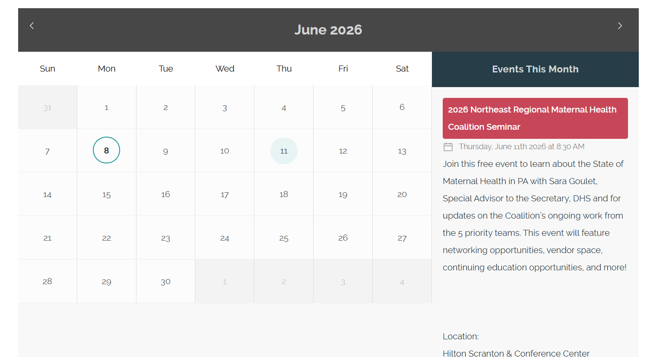
More from the Perinatal Action Collaborative: Events Calendar

Slide 27
Q&A

Slide 28

Thank you!
Sara Goulet
Special Advisor to the Secretary of PA Department of Human Services
dhs.pa.gov
sgoulet@pa.gov

