Slide 1
Perinatal Mental Health Essentials
Penn State Health, Perinatal TiPS Program
Ritika Baweja, MD
Associate Professor Department of Psychiatry and BH & Obstetrics and Gynecology
Penn State Health, COM, Hershey, PA

Slide 2
Disclosures
No conflicts of interest
Some medications discussed today may be described for off-label use in pregnancy/postpartum
AI was used for slide creation. Presenter has created the content and reviewed all the content for accuracy

Slide 3
Objectives
Recognize the importance of treating mental health and substance use disorders in pregnancy and postpartum period.
1
Understand principles and resources when approaching mental health care in perinatal period.
2
Learn about some common myths in mental health in perinatal population.
3

Slide 4

The Scope of Perinatal Behavioral Health
#1
1 in 5
Perinatal depression & anxiety are the
MOST COMMON complication of pregnancy
Pregnant or postpartum women experience
a mental health condition
~50%
Top cause
Of perinatal mental health conditions go undetected and untreated
Suicide & overdose are leading causes of maternal mortality in the US

Slide 5
Consequences of Untreated Perinatal Mental Illness
Pregnancy
For the Mother & Family
Preterm delivery
Low birth weight / Small for Gestational Age
Poor prenatal care adherence
Substance use use/escalation
Increased NICU and postpartum hospitalization
Disordered maternal-infant attachment
Intergenerational mental health impact
Infanticide (rare but real)
Maternal suicide

Slide 6
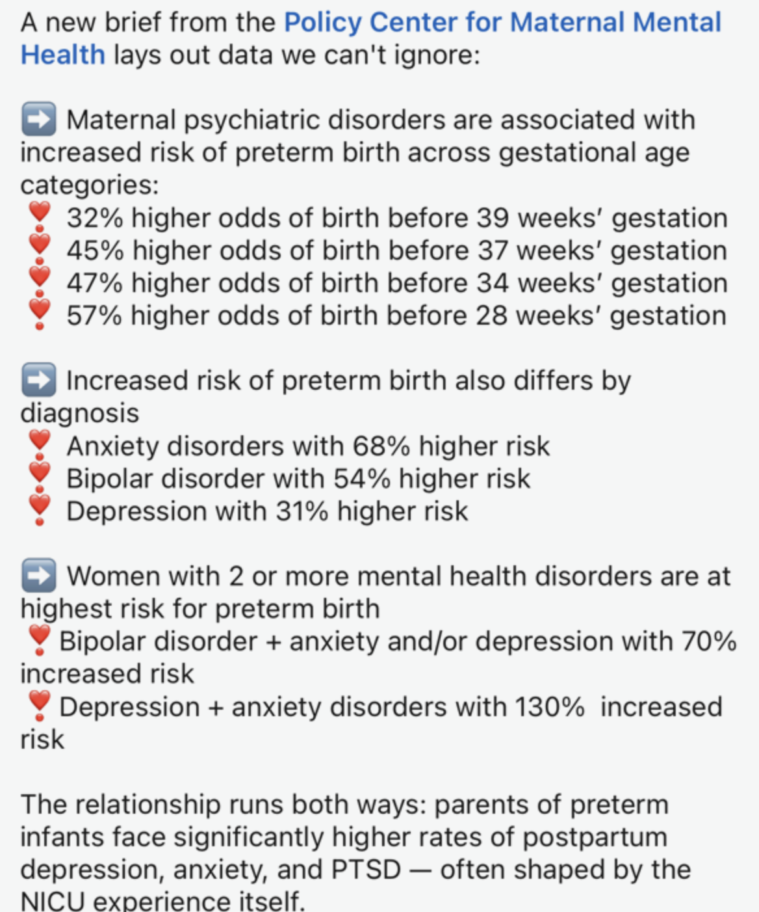
Preterm Birth

Slide 7
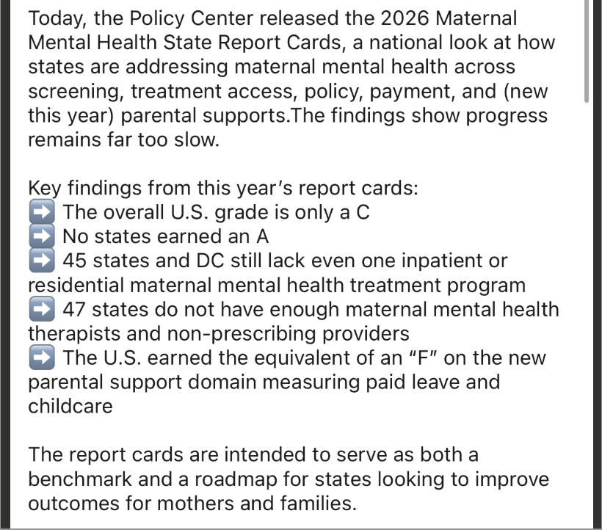

Why Perinatal Mental Health Matters

Slide 8
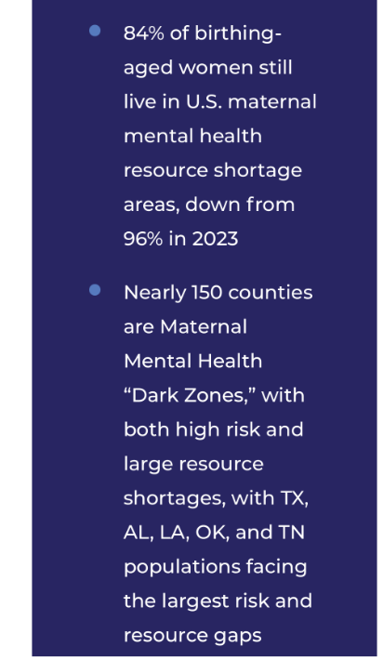
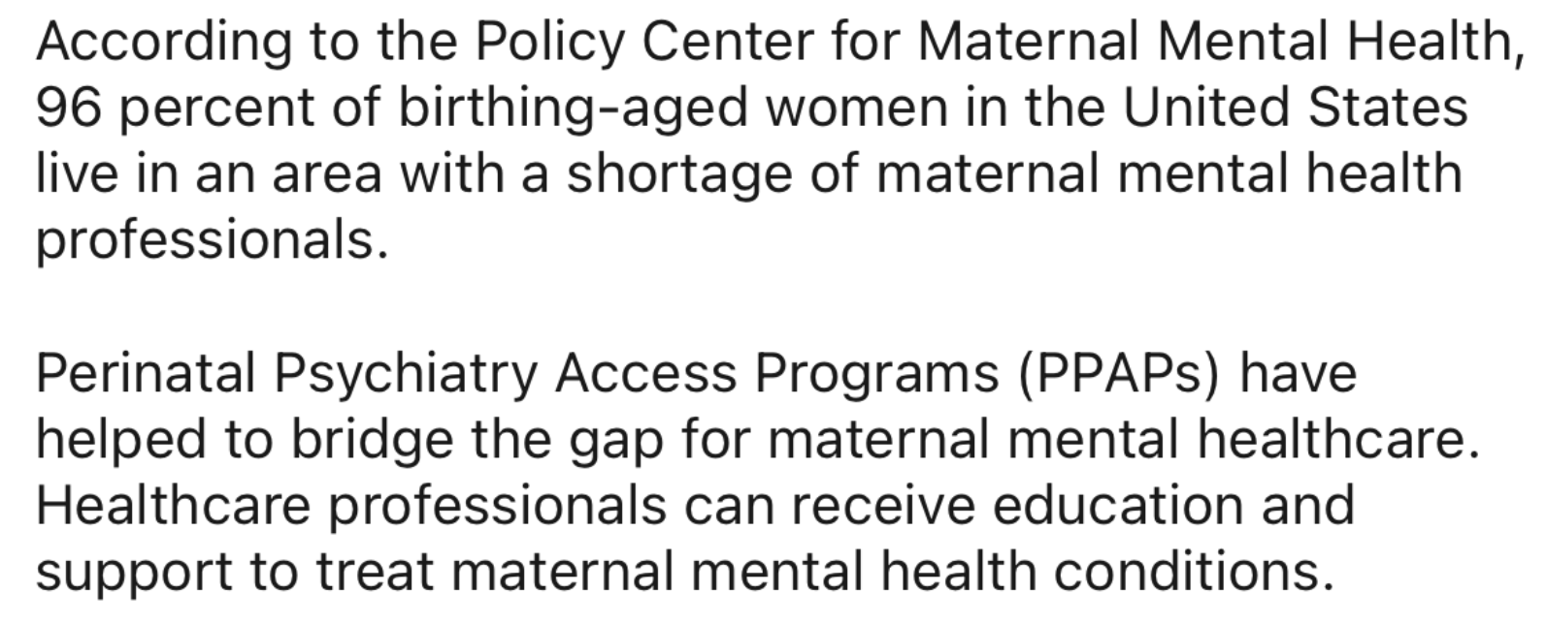
Perinatal Behavioral Health Consultation and Access Program
A free consultation resource for any provider serving the perinatal population.

Slide 9

Pennsylvania Perinatal TiPS Teams
The Perinatal Access line is shared by three health systems:
UPMC Western Psychiatric in Partnership with UPMC Magee-Women’s Hospital:
Northwest and Southwest
Penn State Health University Hershey Medical Center:
Northeast and Lehigh/Capital
Philadelphia Department of Public Health in partnership with Penn Medicine’s Center for Addiction Medicine and Policy and the Children’s Hospital of Philadelphia:
Southeast

Slide 10
What is Perinatal TiPS
Provider-to Provider Telephonic Consultations
Patient-Facing Consultations (billed through insurance)
Care Coordination
Therapy Services (billed through insurance)
Educational Initiatives

Slide 11


What Is Perinatal TiPS?
A FREE telephonic psychiatric consultation program for providers serving pregnant and postpartum patients
Covers patients age 18+ who are pregnant or within 1 year postpartum
Available to ALL provider types: prescribers AND non-prescribers
OB-GYN, PCP, psychiatrists, addiction medicine, NPs, PAs
Social workers, doulas, therapists, home health, case managers, parole officers, SUD providers
Any office staff can call on behalf of a provider
Mon–Fri, 9am–5pm | Speak to a Care Coordinator → consult with psychiatrist/SUD specialist
Who Can Call?
ANY healthcare provider or office staff — prescribing or non-prescribing — who works with perinatal patients.
Contact
Perinatal_TiPS@pennstatehealth.psu.edu

Slide 12
What Perinatal TiPS Is NOT
Not a crisis line:
For psychiatric emergencies, call 988 or go directly to the ED.
Not direct patient care:
TiPS consults are provider-to-provider. Patients do not call directly.
Not a replacement for emergency services:
High-acuity situations still require emergency evaluation.
Not only for prescribers:
ANY provider type can call
Not for patients under 18:
The access line serves patients age 18 and older.

Slide 13

Clinical Case: Stressed Sarah
Clinical Background
The Problem
28-year-old, G2P1, 8 weeks pregnant
Diagnoses: MDD, GAD, ADHD
2 prior suicide attempts (2019, 2023)
Very stable since 2023 on current regimen
EPDS = 1 and GAD-7 = 1 on day of visit
Her OB told her that if she became pregnant it was NOT SAFE to continue her medications. She abruptly stopped ALL medications upon positive pregnancy test — off for 1 week.
Current Medications
Lamotrigine 200mg daily (since 2016)
Vilazodone— most helpful AD
Buspirone 15mg BID (reduced lorazepam need)
Lorazepam 1mg BID PRN (using 1–2x/week)
Lisdexamfetamine 40mg daily (best ADHD response)
Discussion Question
What do YOU do next — based on your role?
• Prescribers: which meds do you restart?
• Non-prescribers: what do you say?
• Others: what resources do you offer?

Slide 14
Busting the Myths in Perinatal Psychiatry

Slide 15

THE REALITY
MYTH #1
Untreated depression is the real risk. Relapse rates after discontinuation of antidepressants in pregnancy are high — up to 68% in some studies.
SSRIs are the most studied. Sertraline prescribed most common. Most antidepressants do not carry significant teratogenic risk.
Risk/ Risk applies both ways. The risks of the illness must be weighed alongside medication risks.
New labeling system: FDA now uses PLLR (Pregnancy and Lactation Labeling Rule) — not the old A/B/C/D/X categories. Provides nuanced, evidence-based information
"All antidepressants are unsafe during pregnancy."

Slide 16
THE REALITY
MYTH #2
Switching introduces NEW risks. Any new exposure adds risk.
Real risk: Switching and failing to respond leaves the patient with BOTH untreated illness AND new medication exposure.
Stability is often the goal. If a patient is stable on her current regimen, maintaining it is usually preferred over switching.
Sertraline ≠ automatically better. Having 'more data' doesn't mean better safety — it means more studied. The drug that WORKS for your patient is the right drug.
"Switching medications to an agent with more data during pregnancy is always safer."

Slide 17
THE REALITY
MYTH #3
80% relapse rate without treatment. Women who discontinue mood stabilizers spend ~40% of their pregnancy in a mood episode vs. 8.8% who continue.
~22 % of positive EPDS cases: First diagnosed with BD in the postpartum period — making screening and proper assessment essential for all.
Lithium is not contraindicated. Gold standard for BD peripartum. Ebstein anomaly risk is very small in absolute terms and dose-related.
Valproate should be contraindicated (CI in Europe). 10.93% major malformation rate. Avoid in all women of reproductive age if at all possible.
Antipsychotics are generally continued. No strong evidence of malformation risk (except risperidone). Olanzapine/quetiapine: monitor for gestational diabetes.
"Women with bipolar disorder must stop all mood stabilizers during pregnancy."

Slide 18
THE REALITY
MYTH #4
Not strictly contraindicated. Risk/benefit discussion is required. Abrupt discontinuation from high doses or long-term use is MORE dangerous than continuation.
Withdrawal can be life-threatening. Especially at high doses or with long-term use — gradual taper is always preferred.
More effective than antihistamines. Sometimes BZDs are more efficacious than diphenhydramine or hydroxyzine in most cases of anxiety disorder.
Sarah's case: Using 1–2 tabs/week PRN. This low-dose, infrequent use has a very different risk profile than daily high-dose use.
"Benzodiazepines and hypnotics are strictly contraindicated in pregnancy."

Slide 19
THE REALITY
MYTH #5
Untreated ADHD risks: Substance use, accidents, legal concerns, occupational failures, teenage pregnancy.
Discontinuation worsens mood. A cohort study showed stopping stimulants caused significant increases in depressive symptoms even in patients on antidepressants.
Impairs functioning. Stopping ADHD medication during pregnancy impairs family and work functioning significantly.
Stimulants can be continued. With individualized risk/benefit discussion and proper monitoring for OB complications like hypertensive disorders of pregnancy, preeclampsia, growth restriction, preterm birth.
"ADHD does not matter in pregnancy."

Slide 20
THE REALITY
MYTH #6
Neurodevelopmental data is largely reassuring. Most studies do not show major long-term adverse neurobehavioral/neurodevelopmental effects from antidepressants.
Untreated depression is associated with poor outcomes. Postpartum depression itself causes adverse neurobehavioral outcomes in children.
"Any medication taken during pregnancy will cause detrimental outcomes and long-term harm to the child."

Slide 21
THE REALITY
MYTH #7
NAS is benign and temporary. Neonatal Adaptation Syndrome affects 25–30% of SSRI-exposed neonates but resolves without intervention in most cases.
Stopping in 3rd trimester increases relapse risk. The postpartum period is the highest-risk window for mood episodes.
"Stopping medication in the last trimester prevents negative outcomes."

Slide 22
THE REALITY
MYTH #9
Most antidepressants: <10% RID. Relative infant dose under 10% is considered safe. Most commonly used antidepressants fall well below this threshold.
Don't switch agents for breastfeeding. If a medication worked in pregnancy, there's no reason to switch because of breastfeeding — exposure through milk is lower than placental transfer.
Benefits of breastfeeding matter too. The benefits of breastfeeding on infant immunity, bonding, and maternal mental health should be part of the conversation.
LactMed is the free resource.
"Taking antidepressants will harm breastfeeding infants."

Slide 23
THE REALITY
MYTH #8
Zuranolone (Zurzuvae) New oral option. Rapid onset (3 days). For onset of depression in 3rd trimester or <4 weeks postpartum. Limited breastfeeding data.
TMS (Transcranial Magnetic Stimulation) Minimizes medication exposure. Emerging safety data in pregnancy. Time-intensive — feasibility varies.
Bright Light Therapy Low risk. Some evidence in perinatal depression. Good adjunct option.
"If a patient doesn't respond to SSRIs, there are no other options."

Slide 24
THE REALITY
MYTH #10
This is definitively false. Research consistently shows that asking about suicidal ideation does NOT increase suicidal thinking or behavior.
It can be life-saving. Screening opens the door to help.
Perinatal period is high risk. Suicide and overdose are leading causes of maternal mortality. Screening is essential, not optional.
We don't need to be a prescriber to screen for safety
"Asking about suicidal thoughts plants the ideas in their minds."

Slide 25
Suicide Risk in the Perinatal Period

Slide 26
Suicide: Risk & Protective Factors
Static Risk Factors
Modifiable Risk Factors
Protective Factors
Mood disorder*
Substance use*
Intimate partner violence*
Psychotic disorder
Access to lethal means
Insomnia / pain
Abrupt medication discontinuation
Engaged in MH / medical care
Supportive family & community
Problem-solving & coping skills
Spiritual / religious beliefs
Future-oriented plans
Reason for living (child, family)
Prior suicide attempt*
Family history of suicide
Younger maternal age
Single / widowed / divorced
Unintended pregnancy
Screen all patients for suicidal ideation as this is a time of high risk for patients
Risk stays increased beyond the initial postpartum period and remains elevated even years after diagnosis of PPD
Suicide most likely to occur in days 42-365 postpartum
*Most robust predictors. Perinatal women who die by suicide use more violent/lethal means than non-perinatal women.

Slide 27

Resources
If you are in crisis or feel unsafe
Call/Text 988 (U.S. Suicide & Crisis Lifeline) – 24/7
Call 911 for immediate emergency
Maternal Mental Health Support (Pregnancy & Postpartum)
National Maternal Mental Health Hotline (U.S. HHS)
📞 1-833-TLC-MAMA (1-833-852-6262)
24/7 confidential support
English & Spanish
For pregnancy, postpartum, loss, and emotional distress
Postpartum & Perinatal Mental Health Support
Postpartum Support International (PSI)
📞 1-800-944-4773 (4PPD)
📱 Text: 800-944-4773 (English) | 971-203-7773 (Español)
Depression, anxiety, OCD, PTSD, pregnancy loss support
Peer support + specialist referrals + online groups

Slide 28
Key Resources for Providers & Patients
Perinatal TiPS
MGH Women's Mental Health
Perinatal_TiPS@pennstatehealth.psu.edu
womensmentalhealth.org
Free PA provider consultation (prescribers & non-prescribers)
Evidence-based clinical decision support, medication guides
Postpartum Support International
Mother to Baby
postpartum.net | 1-800-944-4PPD
mothertobaby.org
Patient & provider support, provider directory, PSI helpline
Free teratology information — evidence on specific medications
LactMed (NLM)
988 Suicide & Crisis Lifeline
nlm.nih.gov/lactmed
Call or text 988
Drug-by-drug breastfeeding safety database
24/7 crisis support for patients and their families

Slide 29
Key Takeaways
1
Weigh risks of untreated illness vs risks of medications in pregnancy and breastfeeding
2
Continue the medication that has worked previously with proper risk/risk discussion
3
Lower dose preferred in pregnancy but provide optimum dosages as sometimes physiologic changes in pregnancy which may warrant increase
4
Do not change in breastfeeding if pt took the agent in pregnancy as placental exposure is more than via breast milk
5
Screen all patients for suicidal ideation as this is a period of high risk

Slide 30









Penn State Health Perinatal TiPS Team
Reproductive and Behavioral Health Psychiatrists
Licensed Therapist
Care Coordinator
Dr. Ritika Baweja
Dr. Marissa Beal
Dr. Melissa Free
Mary Ann Leidinger, LCSW
Pavithra Gali
Obstetrics and Gynecology and Addiction Medicine Experts
Dr. Taffy Anderson
Dr. Eleanor Dunham
Dr. Sarah Kawasaki

Slide 31

Contact: rbaweja1@pennstatehealth.psu.edu
Perinatal_TiPS@pennstatehealth.psu.edu

Slide 32
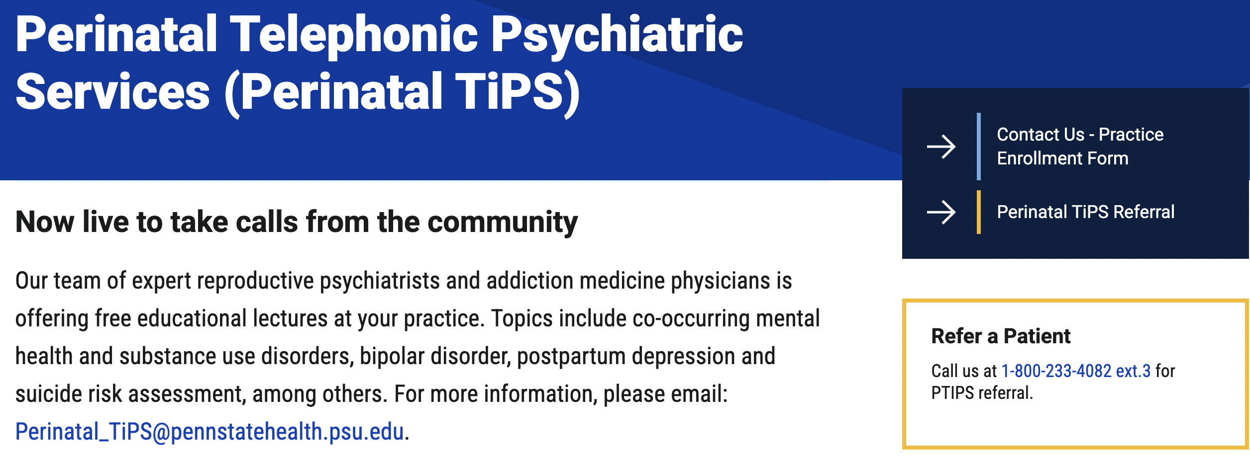

Slide 33


Slide 34
References
Anderson, K. N., Ailes, E. C., Lind, J. N., Broussard, C. S., Bitsko, R. H., Friedman, J. M., ... & Tinker, S. C. (2020). Atypical antipsychotic use during pregnancy and birth defect risk: National Birth Defects Prevention Study, 1997–2011. Schizophrenia research, 215, 81-88.
Andrade, C. (2018). Valproate in pregnancy: recent research and regulatory responses. The Journal of clinical psychiatry, 79(3), 22082.
Andrade, C., Jyothi, S. A., Renitha, T., Anuroopa, K. P., Dona, B., Basila, T., & Nimmy, G. (2021). Use of valproate in women: an audit of prescriptions to 10,001 psychiatry, neurology, and neurosurgery outpatients. The Journal of Clinical Psychiatry, 83(1), 38185.
Atif, N., Lovell, K., & Rahman, A. (2015). Maternal mental health: The missing "m" in the global maternal and child health agenda. Seminars in perinatology, 39(5), 345–352. https://doi-org.ezaccess.libraries.psu.edu/10.1053/j.semperi.2015.06.007
Balbierz, A., Bodnar-Deren, S., Wang, J. J., & Howell, E. A. (2015). Maternal depressive symptoms and parenting practices 3-months postpartum. Maternal and child health journal, 19(6), 1212–1219. https://doi-org.ezaccess.libraries.psu.edu/10.1007/s10995-014-1625-6
Baker, A. S., Wales, R., Noe, O., Gaccione, P., Freeman, M. P., & Cohen, L. S. (2022). The course of ADHD during Pregnancy. Journal of Attention Disorders, 26(2), 143-148.
Bostwick, J. M., Pabbati, C., Geske, J. R., & McKean, A. J. (2016). Suicide Attempt as a Risk Factor for Completed Suicide: Even More Lethal Than We Knew. American Journal of Psychiatry, 173(11), 1094-1100. https://doi.org/10.1176/appi.ajp.2016.15070854
Campbell, J., Matoff-Stepp, S., Velez, M. L., Cox, H. H., & Laughon, K. (2021). Pregnancy-Associated Deaths from Homicide, Suicide, and Drug Overdose: Review of Research and the Intersection with Intimate Partner Violence. Journal of women’s health (2002), 30(2), 236–244. https://doi.org/10.1089/jwh.2020.8875
Chin K, Wendt A, Bennett IM, Bhat A. Suicide and Maternal Mortality. Curr Psychiatry Rep. 2022 Apr;24(4):239-275. doi: 10.1007/s11920-022-01334-3. Epub 2022 Apr 2. PMID: 35366195; PMCID: PMC8976222.
Cohen, L. S., Altshuler, L. L., Harlow, B. L., Nonacs, R., Newport, D. J., Viguera, A. C., ... & Stowe, Z. N. (2006). Relapse of major depression during pregnancy in women who maintain or discontinue antidepressant treatment. Jama, 295(5), 499-507.
Coughlin, C. G., Blackwell, K. A., Bartley, C., Hay, M., Yonkers, K. A., & Bloch, M. H. (2015). Obstetric and neonatal outcomes after antipsychotic medication exposure in pregnancy. Obstetrics & Gynecology, 125(5), 1224-1235.

Slide 35
References
Dennis, C. L., Singla, D. R., Brown, H. K., Savel, K., Clark, C. T., Grigoriadis, S., & Vigod, S. N. (2024). Postpartum Depression:
A Clinical Review of Impact and Current Treatment Solutions. Drugs, 84(6), 645–659. https://doi.org/10.1007/s40265-024-02038-z
Ewing, G., Tatarchuk, Y., Appleby, D., Schwartz, N., & Kim, D. (2015). Placental transfer of antidepressant medications: implications for postnatal adaptation syndrome. Clinical pharmacokinetics, 54(4), 359–370. https://doi-org.ezaccess.libraries.psu.edu/10.1007/s40262-014-0233-3
Fornaro, M., Maritan, E., Ferranti, R., Zaninotto, L., Miola, A., Anastasia, A., ... & Solmi, M. (2020). Lithium exposure during pregnancy and the postpartum period: a systematic review and meta-analysis of safety and efficacy outcomes. American Journal of Psychiatry
Friedman SH, Reed E, Ross NE. Postpartum Psychosis. Curr Psychiatry Rep. 2023 Feb;25(2):65-72. doi: 10.1007/s11920-022-01406-4. Epub 2023 Jan 13. PMID: 36637712; PMCID: PMC9838449.
Gogolu, R. F., Ysbæk-Nielsen, A. T., & Lansner, J. (2025). The effects of antenatal depression and SSRI exposure on children: A systematic review.
Journal of psychopharmacology (Oxford, England), 39(10), 1120–1134. https://doi.org/10.1177/02698811251370973
Gopalan, P., Glance, J. B., & Azzam, P. N. (2014). Managing benzodiazepine withdrawal during pregnancy: case-based guidelines. Archives of women's mental health, 17, 167-170.
Grigoriadis, S., VonderPorten, E. H., Mamisashvili, L., Tomlinson, G., Dennis, C. L., Koren, G., Steiner, M., Mousmanis, P., Cheung, A., Radford, K., Martinovic, J., & Ross, L. E. (2013). The impact of maternal depression during pregnancy on perinatal outcomes: a systematic review and meta-analysis. The Journal of clinical psychiatry, 74(4), e321–e341. https://doi-org.ezaccess.libraries.psu.edu/10.4088/JCP.12r07968
Grote, N. K., Bridge, J. A., Gavin, A. R., Melville, J. L., Iyengar, S., & Katon, W. J. (2010). A meta-analysis of depression during pregnancy and the risk of preterm birth, low birth weight, and intrauterine growth restriction. Archives of general psychiatry, 67(10), 1012–1024. https://doi-org.ezaccess.libraries.psu.edu/10.1001/archgenpsychiatry.2010.111
Huybrechts, K. F., Bröms, G., Christensen, L. B., Einarsdóttir, K., Engeland, A., Furu, K., ... & Bateman, B. T. (2018). Association between methylphenidate and amphetamine use in pregnancy and risk of congenital malformations: a cohort study from the international pregnancy safety study consortium. JAMA psychiatry, 75(2), 167-175.
Huybrechts, K. F., Hernández-Díaz, S., Patorno, E., Desai, R. J., Mogun, H., Dejene, S. Z., ... & Bateman, B. T. (2016). Antipsychotic use in pregnancy and the risk for congenital malformations. JAMA psychiatry, 73(9), 938-946.
Kolding, L., Ehrenstein, V., Pedersen, L., Sandager, P., Petersen, O. B., Uldbjerg, N., & Pedersen, L. H. (2021). Associations between ADHD medication use in pregnancy and severe malformations based on prenatal and postnatal diagnoses: a Danish registry-based study. The Journal of Clinical Psychiatry, 82(1), 437.
McAllister-Williams, R. H., Baldwin, D. S., Cantwell, R., Easter, A., Gilvarry, E., Glover, V., ... & Endorsed by the British Association for Psychopharmacology. (2017). British Association for Psychopharmacology consensus guidance on the use of psychotropic medication preconception, in pregnancy and postpartum 2017. Journal of Psychopharmacology, 31(5), 519-552.
Munk-Olsen, T., Laursen, T. M., Meltzer-Brody, S., Mortensen, P. B., & Jones, I. (2012). Psychiatric disorders with postpartum onset: possible early manifestations of bipolar affective disorders. Archives of general psychiatry, 69(4), 428-434.
Orsolini L, Valchera A, Vecchiotti R, Tomasetti C, Iasevoli F, Fornaro M, De Berardis D, Perna G, Pompili M, Bellantuono C. Suicide during Perinatal Period: Epidemiology, Risk Factors, and Clinical Correlates. Front Psychiatry. 2016 Aug 12;7:138. doi: 10.3389/fpsyt.2016.00138. PMID: 27570512; PMCID: PMC4981602.
Pack AM, Oskoui M, Williams Roberson S, Donley DK, French J, Gerard EE, Gloss D, Miller WR, Munger Clary HM, Osmundson SS, McFadden B, Parratt K, Pennell PB, Saade G, Smith DB, Sullivan K, Thomas SV, Tomson T, Dolan O'Brien M, Botchway-Doe K, Silsbee HM, Keezer MR. Teratogenesis, Perinatal, and Neurodevelopmental Outcomes After In Utero Exposure to Antiseizure Medication: Practice Guideline From the AAN, AES, and SMFM. Neurology. 2024 Jun;102(11):e209279. doi: 10.1212/WNL.0000000000209279. Epub 2024 May 15. Erratum in: Neurology. 2025 Jan 14;104(1):e210145. doi: 10.1212/WNL.0000000000210145. PMID: 38748979; PMCID: PMC11175651.
Paulson, J. F., Dauber, S., & Leiferman, J. A. (2006). Individual and combined effects of postpartum depression in mothers and fathers on parenting behavior. Pediatrics, 118(2), 659–668. https://doi-org.ezaccess.libraries.psu.edu/10.1542/peds.2005-2948

Slide 36
References
Payne J. L. (2021). Psychiatric Medication Use in Pregnancy and Breastfeeding. Obstetrics and gynecology clinics of North America, 48(1), 131–149. https://doi-org.ezaccess.libraries.psu.edu/10.1016/j.ogc.2020.11.006
Reis, M., & Källén, B. (2008). Maternal use of antipsychotics in early pregnancy and delivery outcome. Journal of clinical psychopharmacology, 28(3), 279-288.
Suarez, E. A., Bateman, B. T., Hernández-Díaz, S., Straub, L., Wisner, K. L., Gray, K. J., Pennell, P. B., Lester, B., McDougle, C. J., Zhu, Y., Mogun, H., & Huybrechts, K. F. (2022). Association of Antidepressant Use During Pregnancy With Risk of Neurodevelopmental Disorders in Children. JAMA internal medicine, 182(11), 1149–1160. Advance online publication. https://doi-org.ezaccess.libraries.psu.edu/10.1001/jamainternmed.2022.4268
Tusa, B. S., Alati, R., Ayano, G., Betts, K., & Dachew, B. (2025). Anxiety and depressive disorders in the offspring of mothers with perinatal depressive disorders.
European child & adolescent psychiatry, 34(12), 4117–4129. https://doi.org/10.1007/s00787-025-02803-9
Veroniki, A. A., Rios, P., Cogo, E., Straus, S. E., Finkelstein, Y., Kealey, R., ... & Tricco, A. C. (2017). Comparative safety of antiepileptic drugs for neurological development in children exposed during pregnancy and breast feeding: a systematic review and network meta-analysis. BMJ open, 7(7), e017248.
Viguera, A. C., Whitfield, T., Baldessarini, R. J., Newport, D. J., Stowe, Z., Reminick, A., ... & Cohen, L. S. (2007). Risk of recurrence in women with bipolar disorder during pregnancy: prospective study of mood stabilizer discontinuation. American Journal of Psychiatry, 164(12), 1817-1824.
Wisner, K. L., Sit, D. K., McShea, M. C., Rizzo, D. M., Zoretich, R. A., Hughes, C. L., ... & Hanusa, B. H. (2013). Onset timing, thoughts of self-harm, and diagnoses in postpartum women with screen-positive depression findings. JAMA psychiatry, 70(5), 490-498.
Wang E, Liu Y, Wang Y, Han X, Zhou Y, Zhang L, Tang Y. Comparative Safety of Antipsychotic Medications and Mood Stabilizers During Pregnancy: A Systematic Review and Network Meta-analysis of Congenital Malformations and Prenatal Outcomes. CNS Drugs. 2025 Jan;39(1):1-22. doi: 10.1007/s40263-024-01131-x. Epub 2024 Nov 11. PMID: 39528870; PMCID: PMC11695384.
Watkins, L., Cock, H., Angus-Leppan, H., Morley, K., Wilcock, M., & Shankar, R. (2019). Valproate MHRA guidance: limitation
Wisner, K. L., Sit, D. K., McShea, M. C., Rizzo, D. M., Zoretich, R. A., Hughes, C. L., ... & Hanusa, B. H. (2013). Onset timing, thoughts of self-harm, and diagnoses in postpartum women with screen-positive depression findings. JAMA psychiatry, 70(5), 490-498.
https://www.cdc.gov/physical-activity-basics/guidelines/healthy-pregnant-or-postpartum-women.html#:~:text=Recommendations%201%20Physical%20Activity%20Recommendation%20Get%20at%20least,3%20Examples%20of%20Physical%20Activity%20Brisk%20walking.%20
https://www.acog.org/clinical/clinical-guidance/committee-opinion/articles/2020/04/physical-activity-and-exercise-during-pregnancy-and-the-postpartum-period
Vossler D. G. (2019). Comparative Risk of Major Congenital Malformations With 8 Different Antiepileptic Drugs: A Prospective Cohort Study of the EURAP Registry. Epilepsy currents, 19(2), 83–85. https://doi.org/10.1177/1535759719835353
Treatment and Management of Mental Health Conditions During Pregnancy and Postpartum: ACOG Clinical Practice Guideline No. 5. (2023). Obstetrics and gynecology, 141(6), 1262–1288. https://doi.org/10.1097/AOG.0000000000005202
Zivin K, Zhong C, Rodríguez-Putnam A, et al. Suicide Mortality During the Perinatal Period. JAMA Netw Open. 2024;7(6):e2418887. doi:10.1001/jamanetworkopen.2024.18887
https://www.acog.org/clinical/clinical-guidance/committee-opinion/articles/2020/04/physical-activity-and-exercise-during-pregnancy-and-the-postpartum-period
https://www.cdc.gov/suicide/pdf/NCIPC-Suicide-FactSheet-508_FINAL.pdf
The Periscope Project (Perinatal Specialty Consult Psychiatry)
Massachusetts General Hospital (womensmentalhealth.org)

Slide 37
Thank you

Slide 38



Please complete the survey below.
Go to this web address:
https://redcap.ctsi.psu.edu/surveys/
Then enter this code:
NKRM7MMYT
Penn State Health Perinatal TiPS
This Photo by Unknown Author is licensed under CC BY-NC

