Slide 1
Unpacking Maternal Health Data in Pennsylvania: Trends, Gaps, and Interventions
Aasta D. Mehta, MD, MPP
Director, Division of Maternal, Child, and Family Health
Philadelphia Department of Public Health

Slide 2
Objectives
Understand the scope of severe maternal morbidity and mortality in Pennsylvania
1
Explore contributing factors and disparities
2
Highlight data-driven solutions and collaborative efforts
3

Slide 3
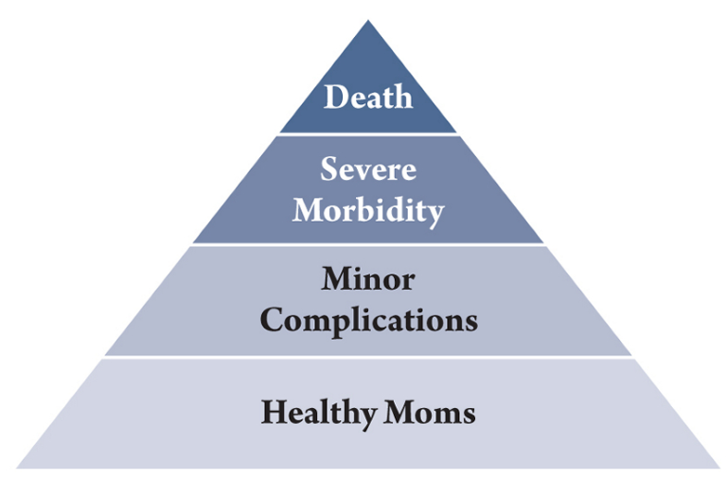
Key definitions
Pregnancy associated mortality: A death during or within one year of pregnancy, irrespective of cause
Pregnancy related mortality: A death during or within one year of pregnancy from a pregnancy complication, a chain of events initiated by pregnancy, or the aggravation of an unrelated condition by the physiologic effects of pregnancy
Severe maternal morbidity: unexpected outcomes of labor and delivery that result in significant short- or long-term consequences to a woman’s health

Slide 4
Severe maternal morbidity

Slide 5
SMM’s impact on maternal and infant health
Adverse delivery outcomes
Intrauterine fetal death and infant mortality
NICU admission
preterm birth
Greater risk of cardiovascular disease after pregnancy, both in the short and long term
Higher risk for postpartum mental illness which impacts:
mother-child bonding
mother’s ability to parent
associated with behavioral and cognitive development in off-spring
Notes:
Aasta
Outside of understanding SMM as a proxy for preventing maternal mortality, SMM by itself can have long term health impacts for both mom and baby. SMM has been associated with ad
Independently, SMM and postpartum mental illness each have significant implications for the health and well-being of both mother and child. Our findings indicate that women with SMM are at an increased risk for postpartum mental illness, resulting in increased challenges for both women and their children. Postpartum mental illness can affect mother-child bonding and affect a mother’s ability to parent, and has been associated with behavioral and cognitive development in off-spring
(1) ongoing health effects
(2) some SMMs-->mistrusts of the health care system; which has ramifications to long term health; NOT JUST THE WOMAN, it's the family; we traumatize families this way

Slide 6
Impact of reducing SMM
Many cases of severe maternal morbidity are preventable.
Richer understanding of maternal health before, during, and after childbirth is a foundation for developing safer, more effective approaches to maternal health care and is critical to influencing long term health.
Notes:
Aasta

Slide 7
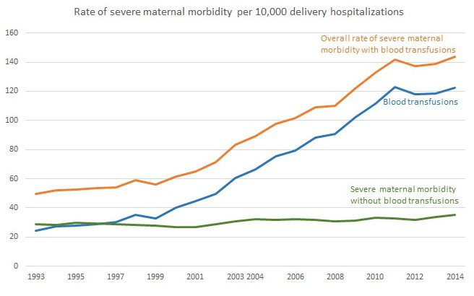
National SMM Data
Notes:
Aasta
The CDC tracks these morbidity and mortality trends closely, and addressing the maternal morbidity epidemic is a priority of all major obstetric societies.
ADINA

Slide 8
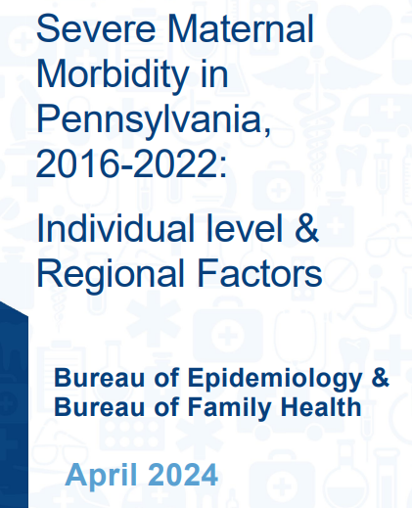

Slide 9
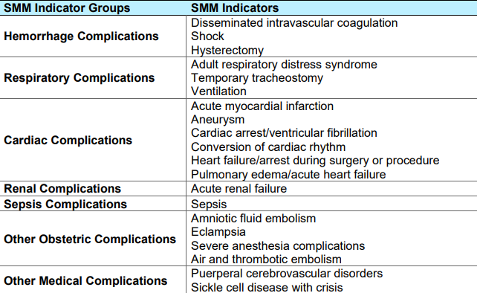
How is this data captured?
Pennsylvania Health Care Cost Containment Council (PHC-4)
Inpatient diagnosis and procedure codes
Patient county of residence
CDC: algorithm to identify SMM events during hospitalization
16 diagnosis codes
5 procedural codes

Slide 10
SMM in PA: 2016-2022

Slide 11
Rates by county of residence

Slide 12
SMM by Indicator, 2016-2022

Slide 13
Change in rate of SMM by Indicator

Slide 14
SMM Rate by Patient Characteristics, 2016-2022
Notes:
Aasta

Slide 15
Key takeaways
Notes:
Aasta

Slide 16
Philadelphia SMM Surveillance
Philadelphia BOH passed regulation in 2023 mandating reporting of SMM to Philadelphia Department of Public Health
>4 units PRBC transfusion
ICU admission
Postpartum hospital stay >5 days
Postpartum hospital readmission (within 30 days)
Goal:
Accurately understand true SMM cases in Philadelphia Hospitals in real time
Correlate SMM incidence with clinical diagnosis and individual risk factors
Notes:
Aasta

Slide 17
Key takeaways
What we do know:
Gaps in what we know:
SMM incidence increases with age
Black birthing individuals are more likely to have an SMM event than all other races
Incidence similar in both rural and urban settings
Increased incidence of SMM in the Medicaid population
Current data derived only from administrative data:
Inter-institutional coding variability
May not reflect most clinically significant cases
Can only determine correlation, not causation
Does not include hospital readmissions
Unable to ascertain clinical risk factors, only standard demographics
Are we seeing a true trend upwards or are we just capturing this information better?

Slide 18
Maternal mortality

Slide 19
The significance
Infrequent and relatively small number, but an important one
Reflects the quality and effectiveness of our healthcare system
Beyond healthcare, it’s a measure of societal well-being and care
Societal implications are vast:
The loss of a mother deprives families of a key pillar.
We lose significant productive years and societal contributions.
Most heartbreakingly, children are left without their mothers.
Notes:
Maternal mortality acts as a mirror, reflecting the overall 'effectiveness' of our healthcare delivery system. It's not just about medical care; it delves deeper, gauging the broader societal well-being. When a mother doesn't survive childbirth or complications related to it, it questions the very core of our healthcare infrastructure and societal frameworks.
From an anthropologic standpoint, the impact is vast and deeply rooted. The loss of a mother is not merely a personal tragedy for her family. It signifies an overall societal loss, disrupting the intricate fabric that binds communities together.
Women contribute immensely to society in numerous capacities. Their untimely loss means a loss of productive years, where they could have offered so much more to the world around them. The ripple effects of this are profound, from the socio-economic implications to the heartrending reality of children left motherless.
In essence, while the numbers may seem small, the repercussions of maternal mortality are monumental. It underscores the urgent need for robust and effective healthcare systems and societal supports, ensuring every woman's safety and well-being.“
Though these cases might seem few, each one is a stark reflection of our healthcare system's capabilities. But it doesn't stop there. It's also a measure of our societal health and values.
Think about the ripple effects:
Families are shattered with the loss of a central figure.
Our society misses out on invaluable contributions, given the productive years lost.
And perhaps most tragically, we see children forced to navigate life without their mothers.
Each instance of maternal mortality isn't just a statistic. It's a rallying cry, urging us toward more comprehensive healthcare and stronger societal structures."

Slide 20
Maternal mortality has been gradually declining before recently rising

Slide 21
The United States vs. everyone else

Slide 22
PA Pregnancy Associated deaths: 2013-2018

Slide 23
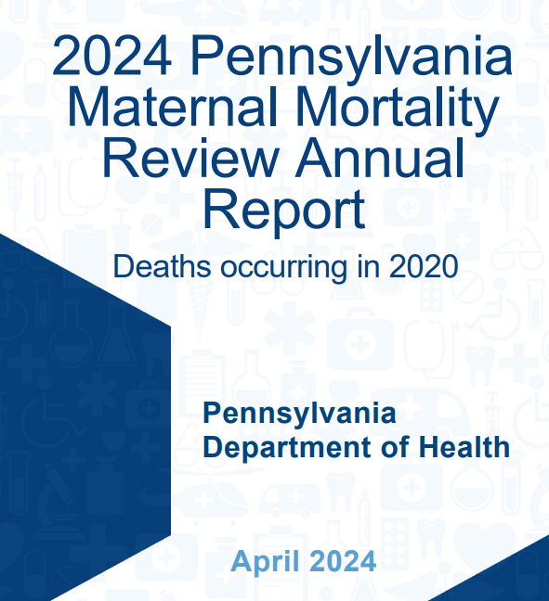
Pennsylvania Maternal Mortality Review Committee
Established in 2018
Led by PA Department of Health
Review all pregnancy associated deaths of PA residents
Multidisciplinary membership
Notes:
The City of Philadelphia has a long history of reviewing pregnancy associated deaths . Our committee was established in 2010 and is one of two active county level teams in the country. The team is composed of a multidisciplinary group of stakeholders spanning across the maternal health ecosystem including health care providers and hospital systems, insurance providers, community based organizations, city agencies, and community members. Since 2010, we have released two reports, the second one which was released just a month ago. It is from this report that I will share with you the latest pregnancy associated data.

Slide 24
Causes of death

Slide 25
Northeast Region

Slide 26
Pregnancy-Related Mortality Ratio by Urban/Rural Classification, Pennsylvania, 2020
*Urban/Rural Classification designated at the county level by the Center for Rural Pennsylvania

Slide 27
Pregnancy-Related Mortality Ratio by Race in Pennsylvania, 2020
Includes individuals who identify as Hispanic/Latine ethnicity and White or Black race.

Slide 28
Northeast Region
17%
75%
8%

Slide 29
Timing

Slide 30
Northeast Region

Slide 31
Preventability
CDC: death that may have been “averted by one or more reasonable changes to patient, community, provider, facility, and/or systems”
93% of pregnancy related deaths in PA are thought to be preventable

Slide 32
Themes
Implement strategies to combat medical mistrust
Doulas, CHWs, CRSs
Workforce diversity
Implicit bias training
Enhance care transitions
Health system/community
Obstetric providers/primary care, mental health, and other subspecialties
Hospitals/outpatient providers
Community awareness of pregnancy risks/complications
Public health campaigns
Investing in strategies to make people’s lives better
Guaranteed income
AIM bundle on reducing health disparities
Targeted education for partners/support people/families
Paid family leave
Affordable housing
Food security/access to healthy foods
Education

Slide 33
The OVA (est. 2020) (Organized Voice for Action)
An Origin Story

Slide 34
(Un) coordinated Action
Review: identify systemic shortfalls and gaps in community resources
In the past: implementation of recommendation depended on interest/capacity of individual stakeholders
Unable to fully scale up interventions
Creation of silos and potential for duplication
Maternal mortality: complex problem crossing many sectors
Notes:
In the past, the Philadelphia MMRC relied on individual stakeholders to implement recommendations that came from the review process. This methodology meant that stakeholders were not able to fully scale up interventions and it decreased the likelihood of a population level change. It also created silos which at times led to duplication of services. We recognized that maternal mortality is a complex problem that spans many sectors and that in order to truly change the trajectory, we need to start working together.

Slide 36
Implementation Strategy
Established backbone which included a person with lived experience
Multi-sector stakeholder interviews:
Structure of collaborative and how can it be effective?
Who should be a part of the collaborative?
What is the main way you/organization is taking action? What assumptions led you to this approach?
Convened Initial Steering Committee
Data driven sectors including people with lived experience
Stakeholder interviews
Governance structure
Equity plan
Final steering committee
Notes:
Our strategy when forming the OVA was to first establish backbone group which included a community member. This person actively participated in the planning process and reviewed all materials as we began implementation. We then conducted a number of stakeholder interviews to get a sense of what the structure of the collaborative should be, who should be involved, and a baseline understanding of what is already happening. We convened an initial steering committee based on these interviews as well as members representing sectors we identified as high priority based on our data. This initial steering committee helped establish our governance structure, equity plan, our final steering committee and even our logo down to the color choice!!

Slide 37
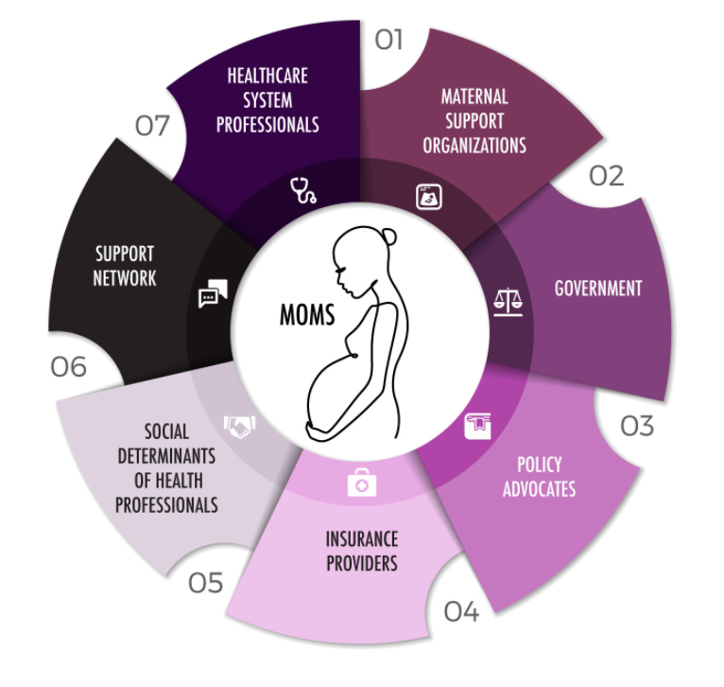
Who’s at the table and why?
Key: individuals with agency to implement programs/policies within their organization and authorize collaboration with other groups
Prioritize and develop implementation strategy of MMRC recommendations
Opportunity to provide organizational updates and network
Notes:
Our current steering committee has multisector representation including all the stakeholders listed here. We were not only strategic about the sector representation but also about WHO was representing each sector. We intentionally chose individuals who had the agency to implement change within their organization and authorize collaboration with other groups. Thus far, our steering committee has been integral in prioritizing and developing an implementation strategy for our MMRC recommendations. They have also had the opportunity provide organizational updates and network with each other, an opportunity that would not have existed without this process and another successful bridge built!

Slide 38
Community Voice Integration
Steering Committee
Co-chairs of various initiatives
Ongoing meetings for process feedback
Key: ensuring that at least 2-4 individuals lived experience are at the table when decisions are made
Key: ensuring we pay individuals for their time, including meeting prep, and that those payments are processed in a timely fashion
Key: ensure accountability by building processes for periodic audits in governance
Notes:
As I mentioned, we were very intentional in integrating community members from the beginning. They were actively involved as part of the backbone when the coalition was conceived, they were members of our initial steering committee, and are now actively involved on the current steering committee, are co-chairs of the workgroups that are carrying out recommendations from the review process, and are involved in ongoing meetings with the backbone to provide process feedback. Given our stark racial disparities in pregnancy related deaths, we also wanted be intentional about incorporating equity into our process. We have done this by including an equity statement in our governance and have periodic equity audits so ensure accountability.

Slide 39
The OVA Framework

Slide 41
Challenges
Sustainable funding
Recruitment
Collaboration
Navigation of diverse viewpoints
Slow project progression

Slide 42
Lessons learned
Collaboration is hard.
It’s ok to pivot!
Community buy-in/trust building is paramount.
Ensure periodic re-visiting of the mission.

Slide 43
Philly SAFE
All obstetric hospitals in Philadelphia have or are in process of integrating an evidence based IPV screening tool into their EMRs
Online training modules developed and disseminated to all hospital staff conducting screening
First city-wide awareness campaign about IPV and pregnancy created and disseminated
Warm handoff referral system strengthened through:
Enhancement of the IPV hotline
Development of a concrete goods fund for emergency transportation and housing, available 24/7

Slide 44
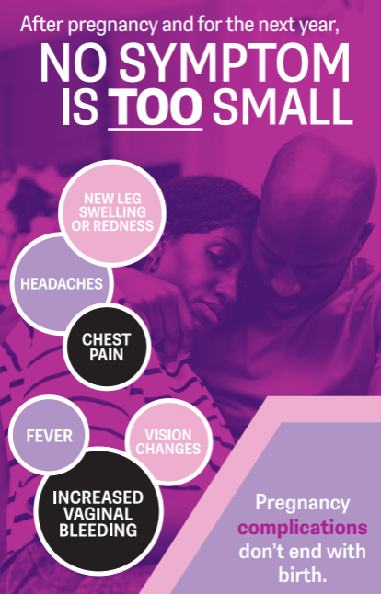
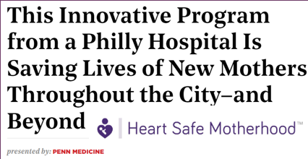
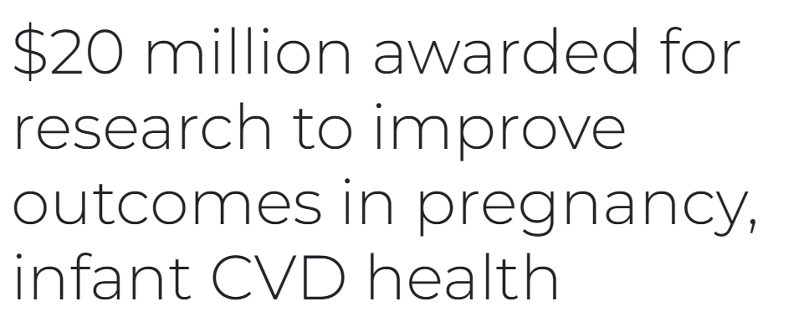

Slide 46
Bringing it all together
Issues are a result of systemic failures spanning generations.
We may not see the fruits of our labor for decades.
It’s about what you do AND how you do it. Centering needs and voices of Black birthing people is vital.
We need to innovate! The same old interventions are just that—old!
Take the harm reduction approach—fix the things you can right now through thoughtful investment and program planning while also working methodically and strategically on the upstream issues.
The system is perfectly designed for the outcomes it achieves—LET’S START DISRUPTING!!

Slide 47
Thank you!
Aasta.mehta@phila.gov
www.Birthjusticephilly.com

